Slide 1
Introduction to C# App Programming
Chapter 3 of Visual C# How to Program, 6/e

Slide 2
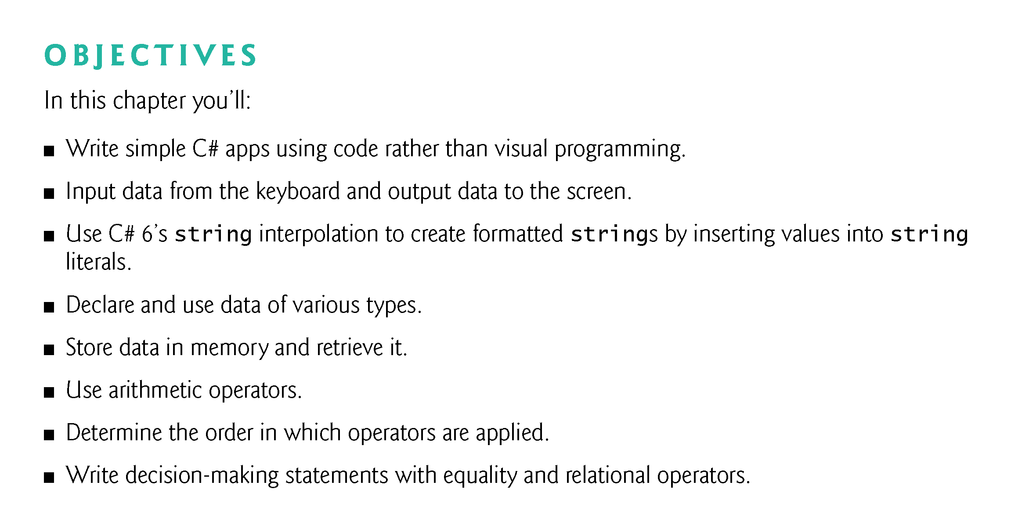

Slide 3
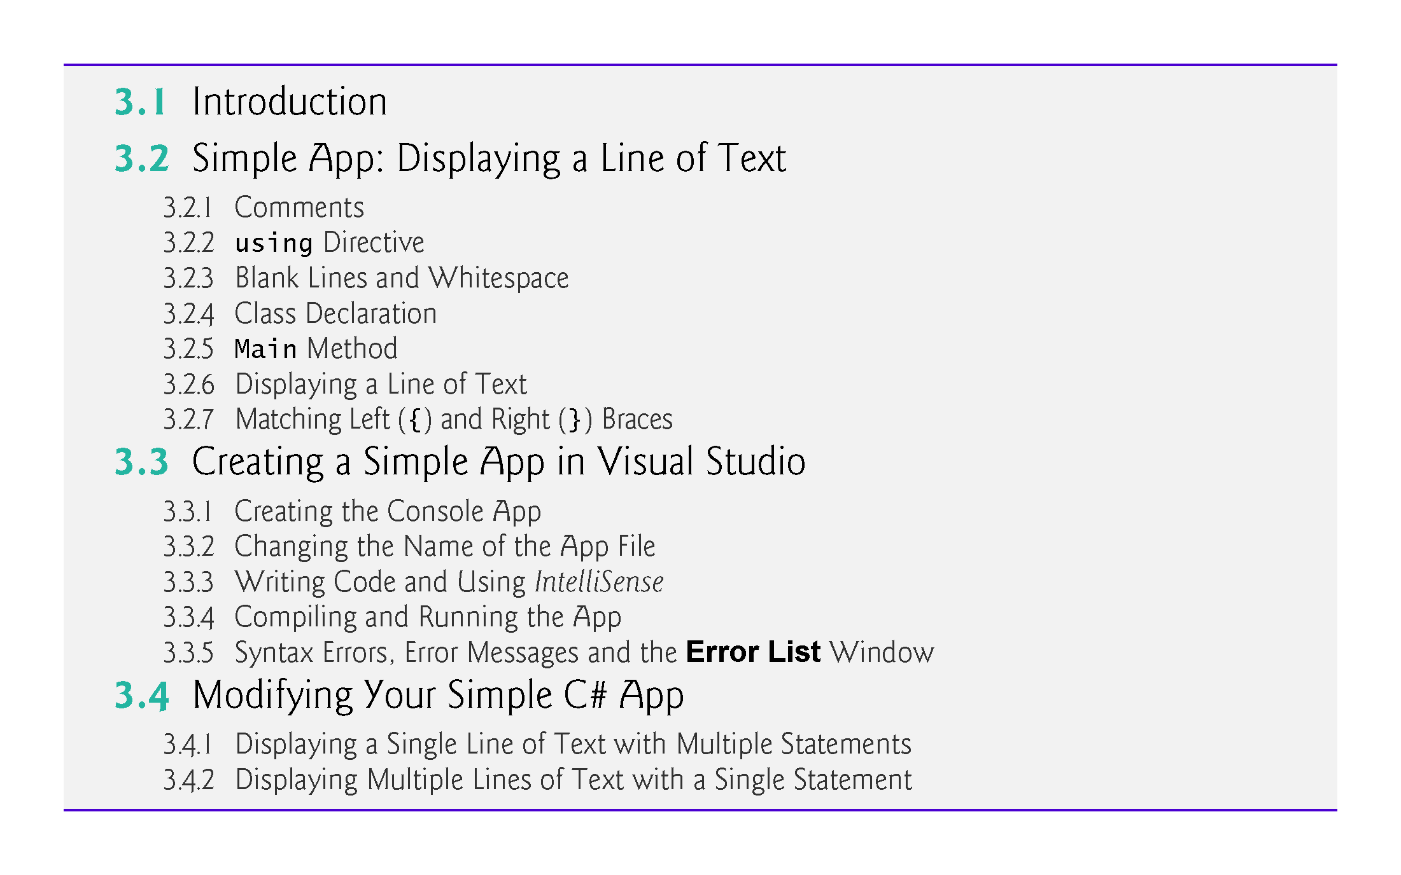

Slide 4
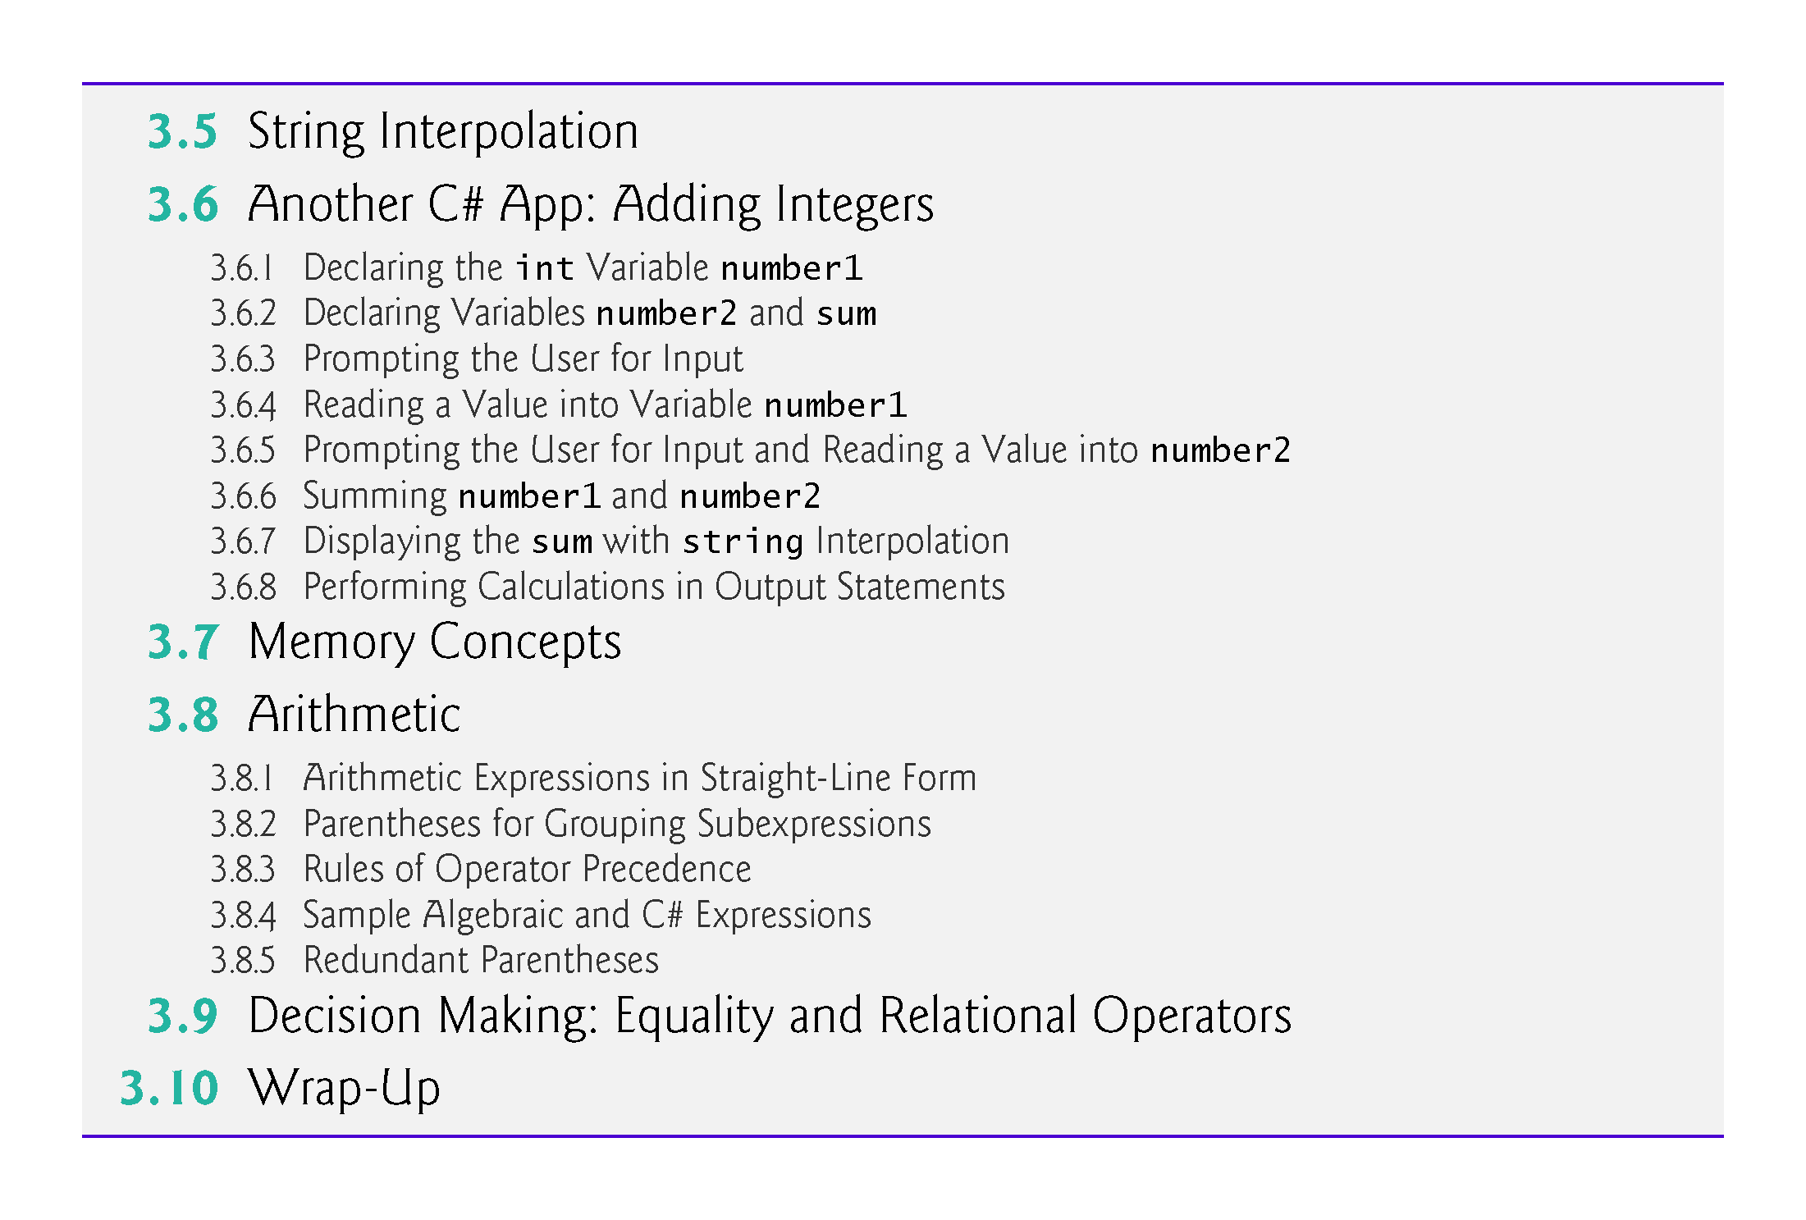

Slide 5
3.1 Introduction
Console apps input and output text in a console window, which in Windows is known as the Command Prompt.
Figure 3.1 shows the app’s source code and output.

Slide 6
3.2 Simple App: Displaying a Line of Text
Figure 3.1 shows the app’s source code and output.

Slide 7
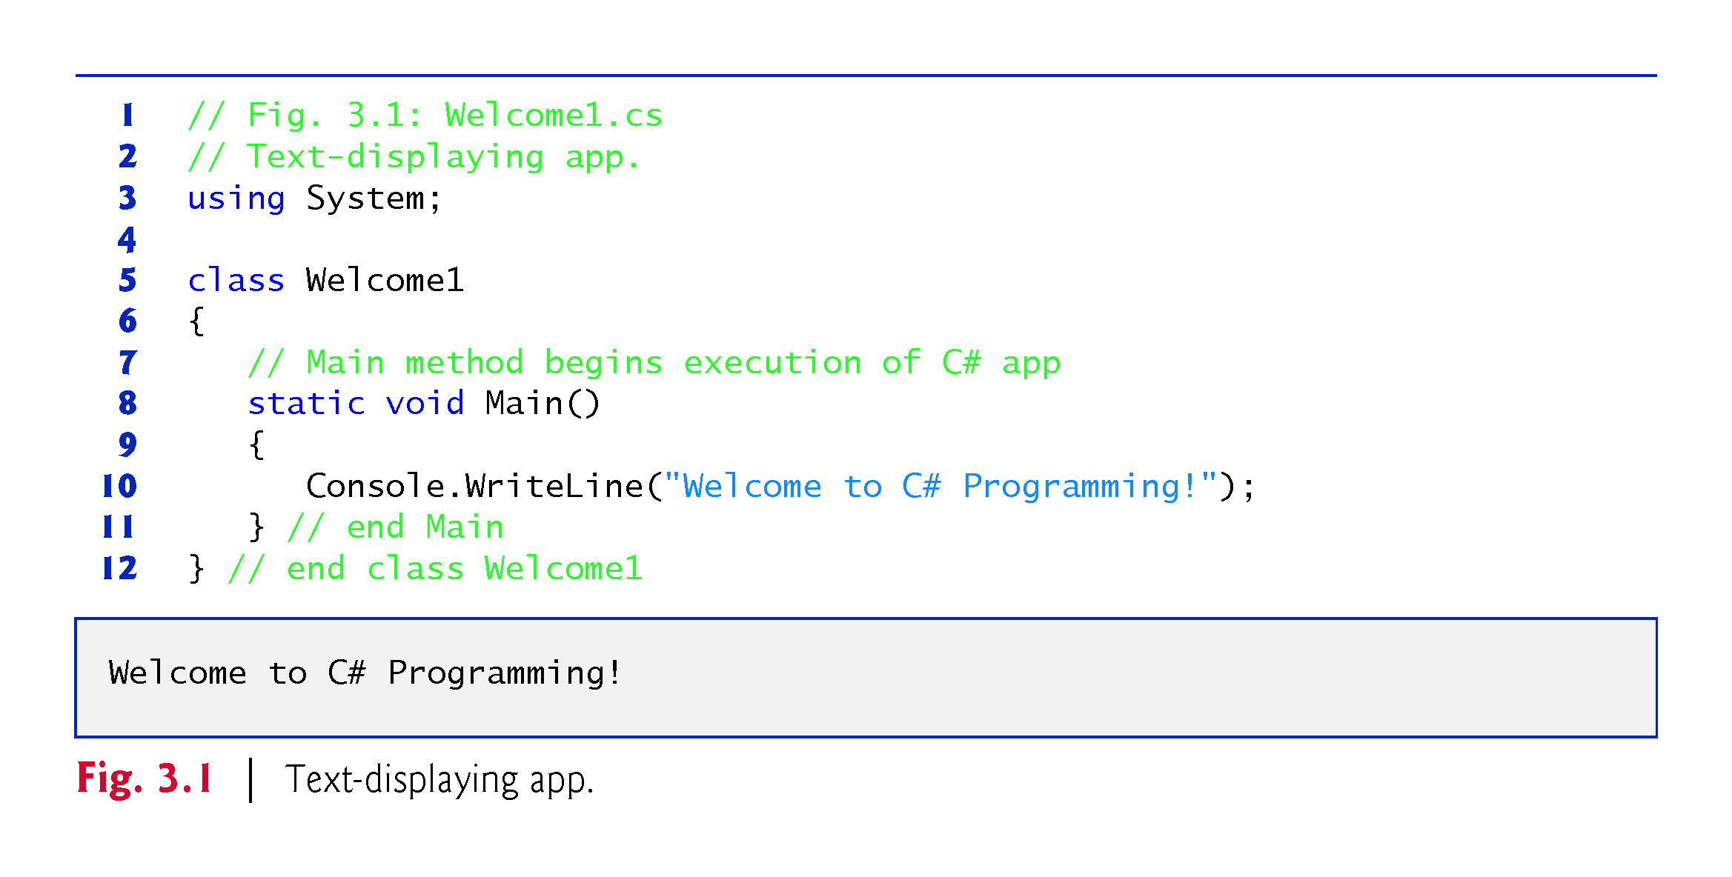

Slide 8
3.2.1 Comments
You’ll insert comments to document your apps and improve their readability.
The C# compiler ignores comments, so they do not cause the computer to perform any action when the app executes.
A comment that begins with // is called a single-line comment, because it terminates at the end of the line on which it appears.

Slide 9
3.2.1 Comments
A // comment also can begin in the middle of a line and continue until the end of that line.
Delimited comments begin with the delimiter /* and end with the delimiter */. All text between the delimiters is ignored by the compiler.

Slide 10
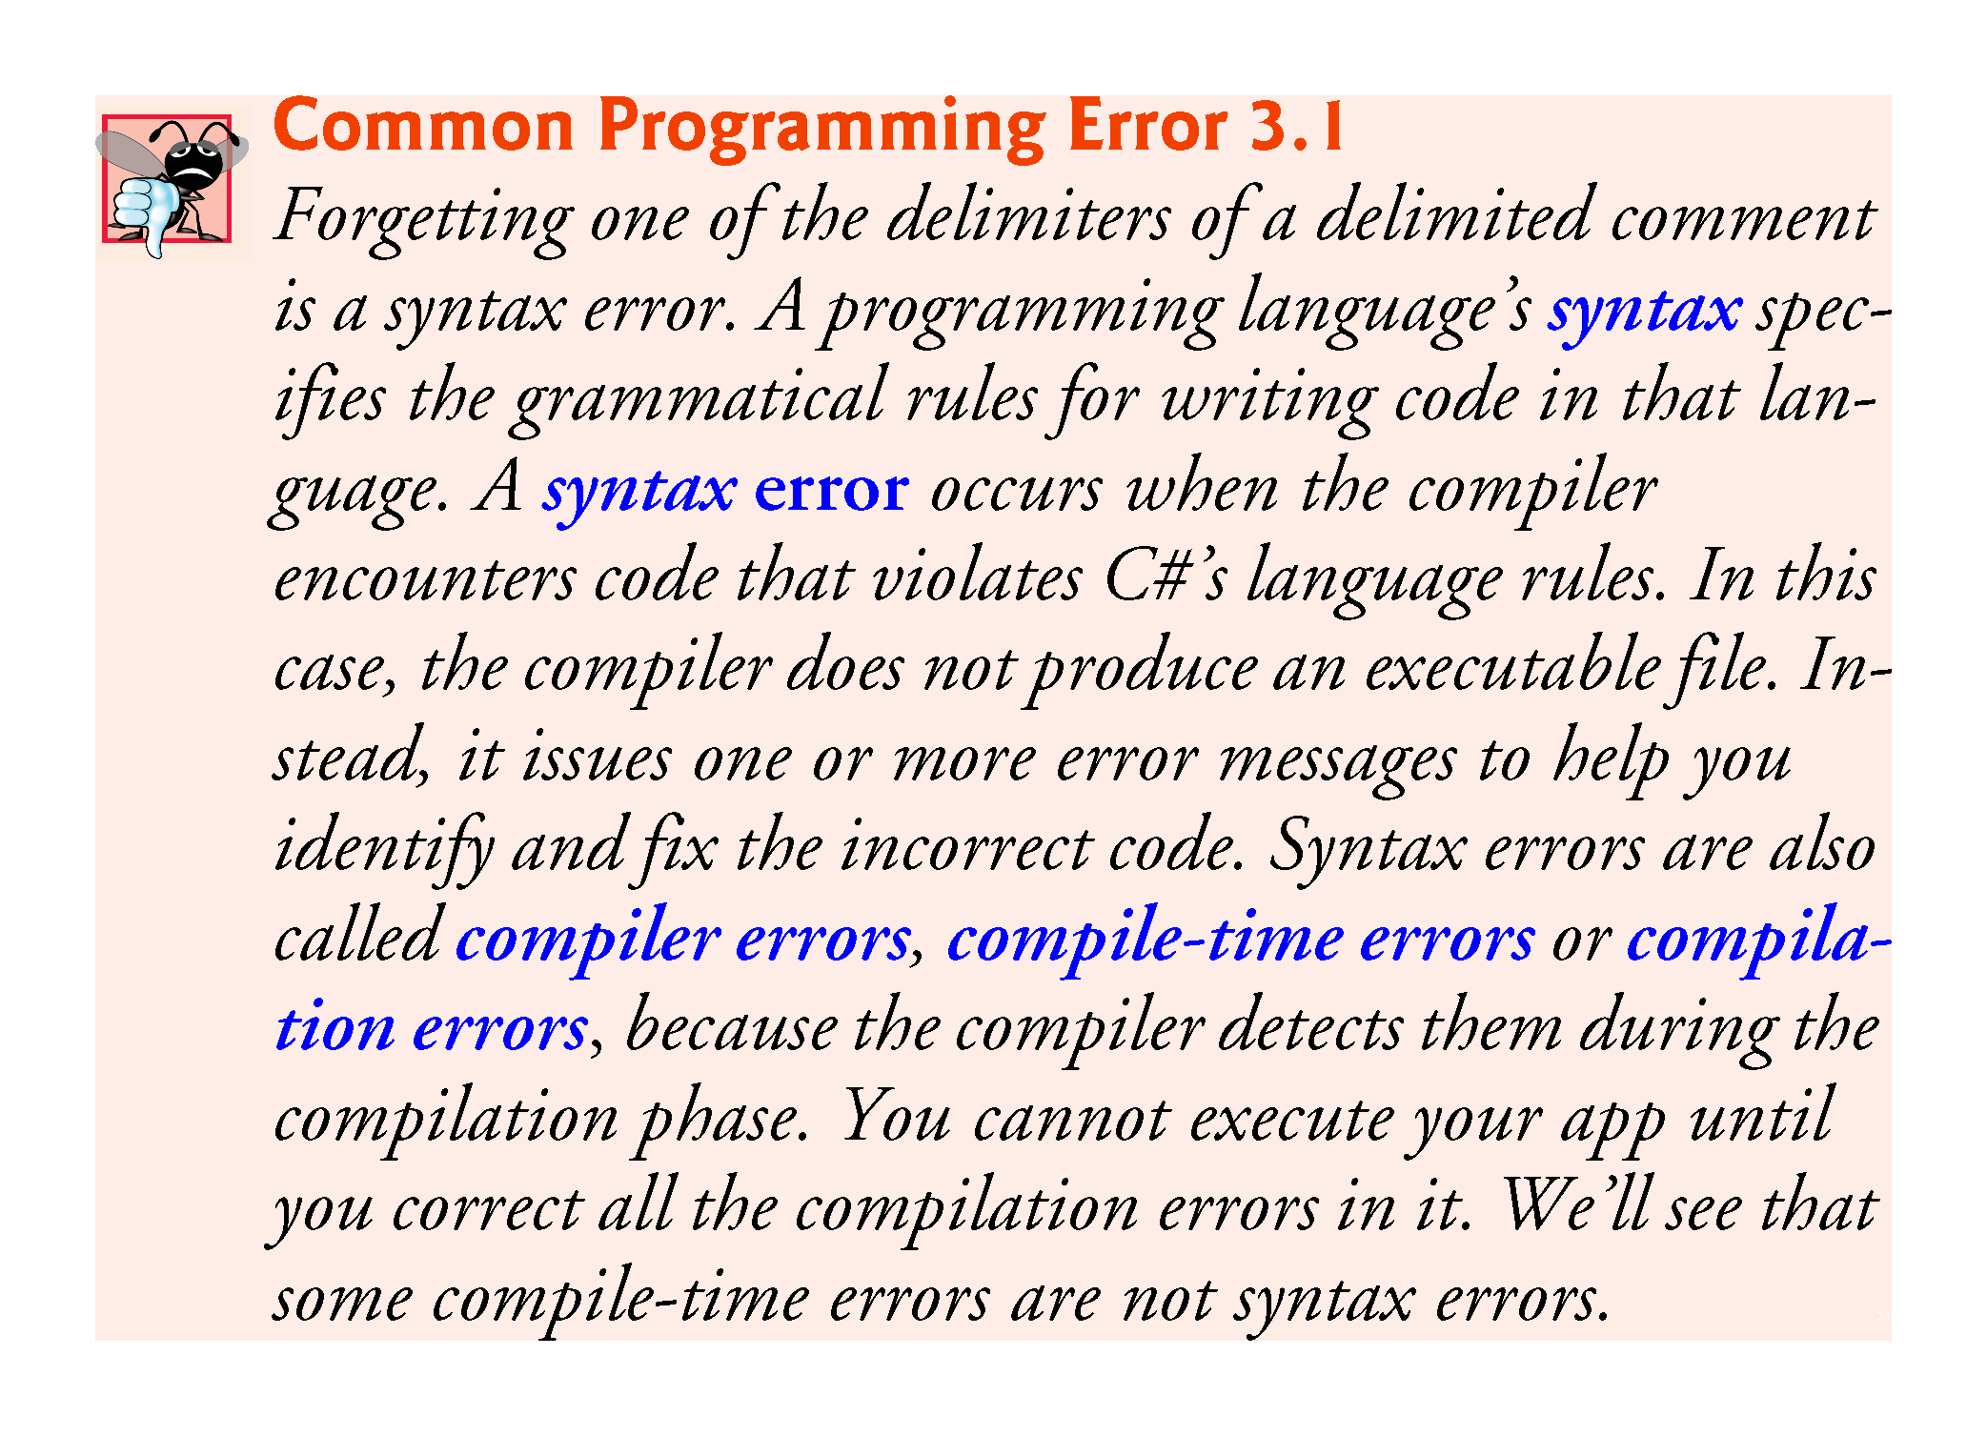

Slide 11
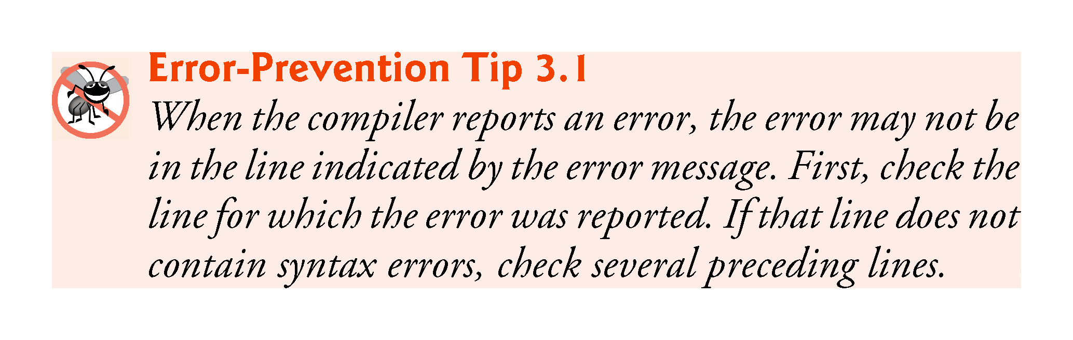

Slide 12
3.2.2 using Directive
A using directive tells the compiler where to look for a predefined class that’s used in an app.
Predefined classes are organized under namespaces—named collections of related classes. Collectively, .NET’s predefined namespaces are known as the .NET Framework Class Library.
The System namespace contains the predefined Console class and many other useful classes.

Slide 13
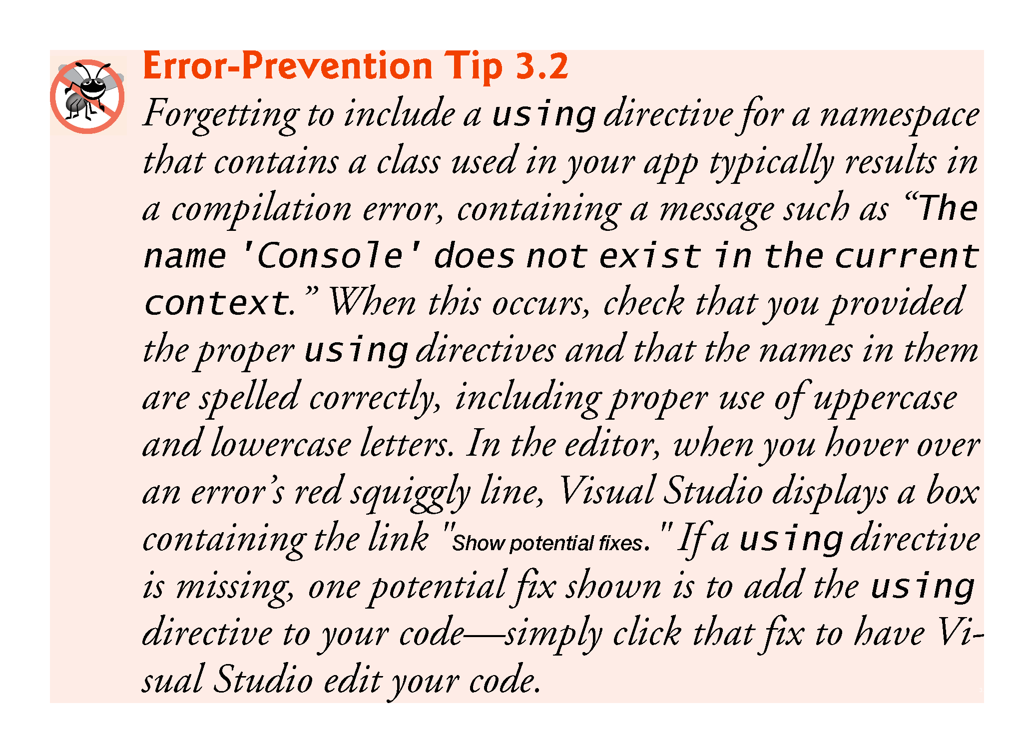

Slide 14
3.2.3 Blank Lines and Whitespace
Blank lines and space characters make code easier to read and together with tab characters are known as whitespace.
Whitespace is ignored by the compiler.

Slide 15
3.2.4 Class Declaration
Keywords (sometimes called reserved words) are reserved for use by C# and are always spelled with all lowercase letters.
Every app consists of at least one class declaration that is defined by the programmer. These are known as user-defined classes.
The class keyword introduces a class declaration and is immediately followed by the class name.

Slide 16
3.2.4 Class Declaration
A class name is an identifier:
Series of characters consisting of letters, digits and underscores.
Cannot begin with a digit and does not contain spaces.
The complete list of C# keywords is shown in Fig. 3.2.
The contextual keywords in Fig. 3.2 can be used as identifiers outside the contexts in which they are keywords, but for clarity this is not recommended.

Slide 17
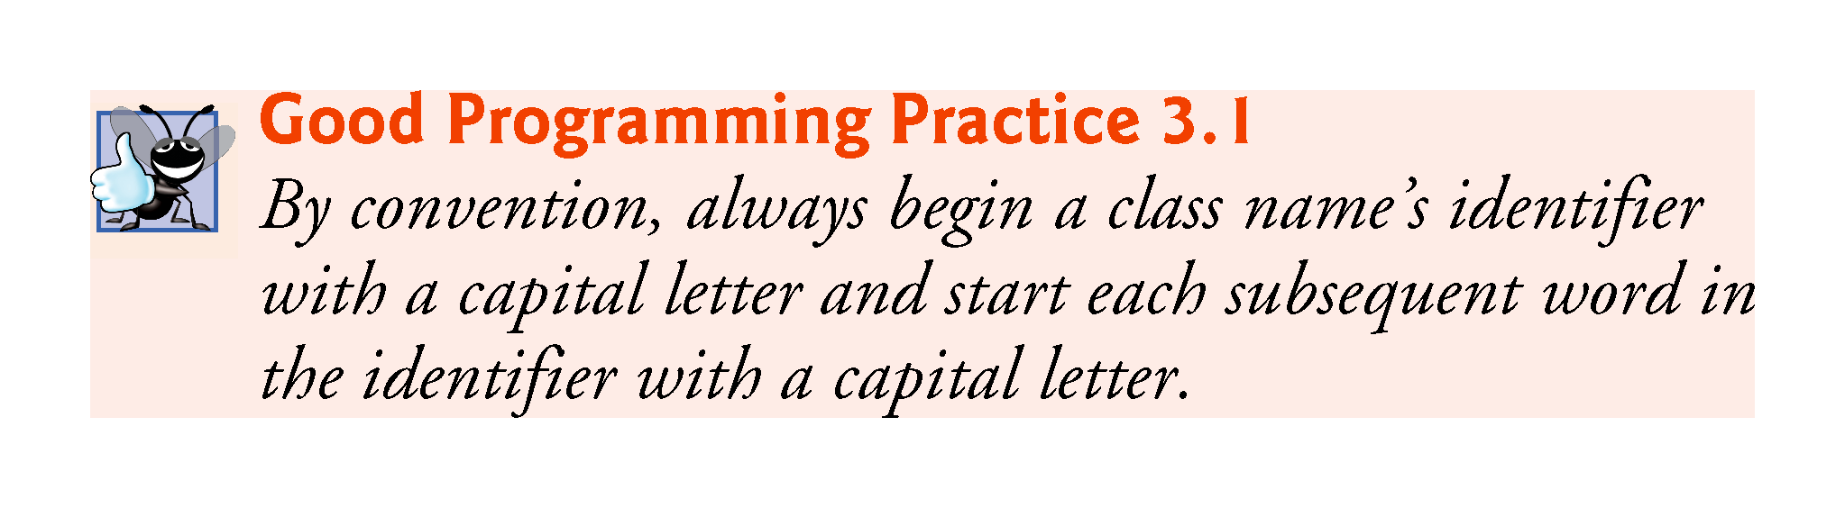

Slide 18
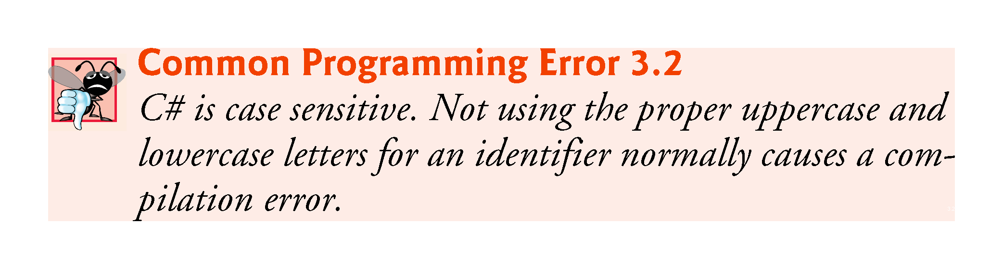

Slide 19


Slide 20
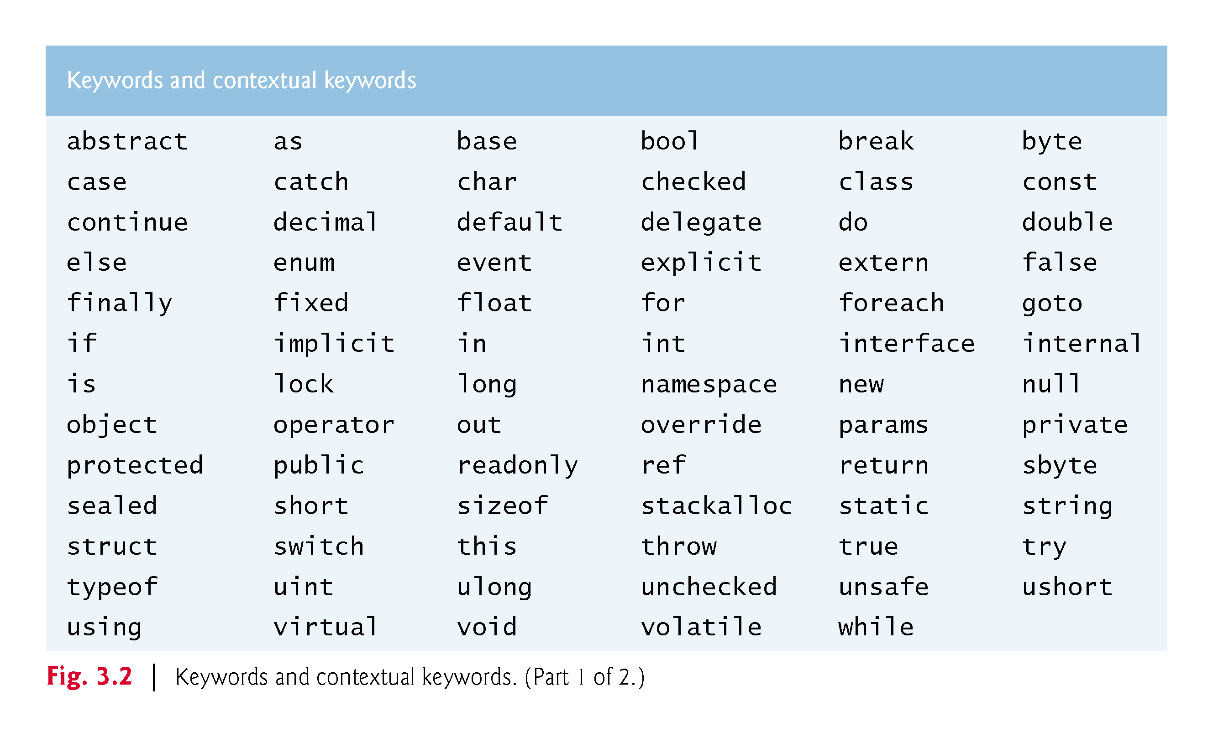

Slide 21
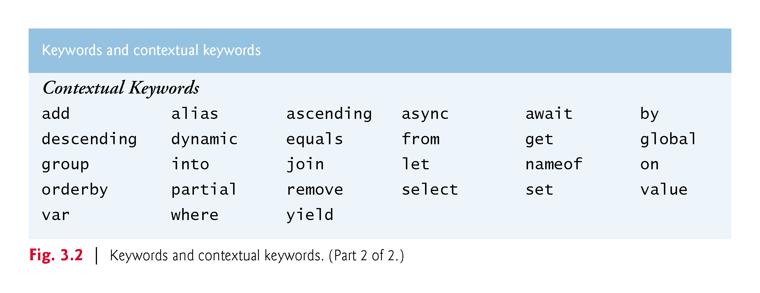

Slide 22
3.2.4 Class Declaration
C# is case sensitive—that is, uppercase and lowercase letters are distinct, so a1 and A1 are different (but both valid) identifiers.

Slide 23
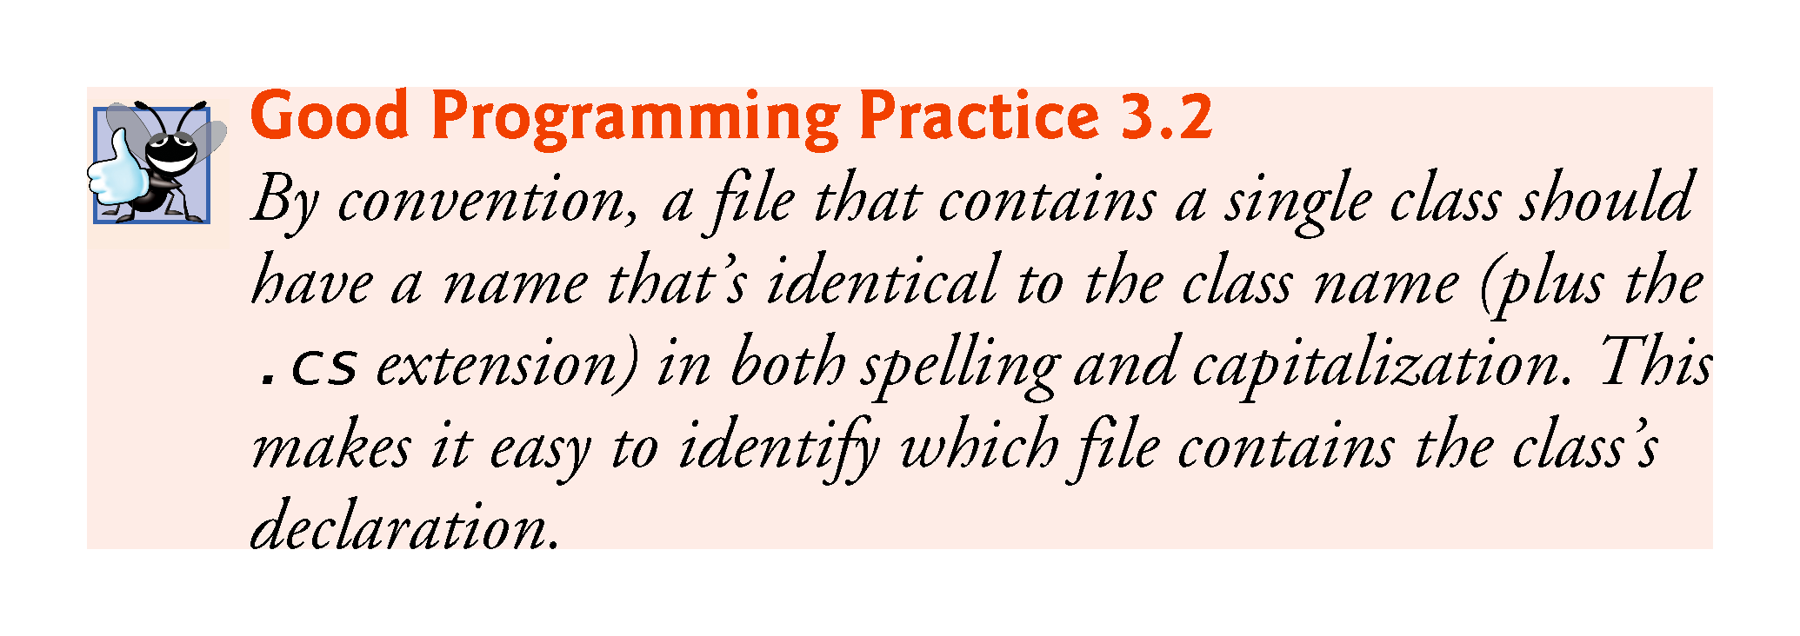

Slide 24
3.2.4 Class Declaration
A left brace, {, begins the body of every class declaration.
A corresponding right brace, }, must end each class declaration.

Slide 25
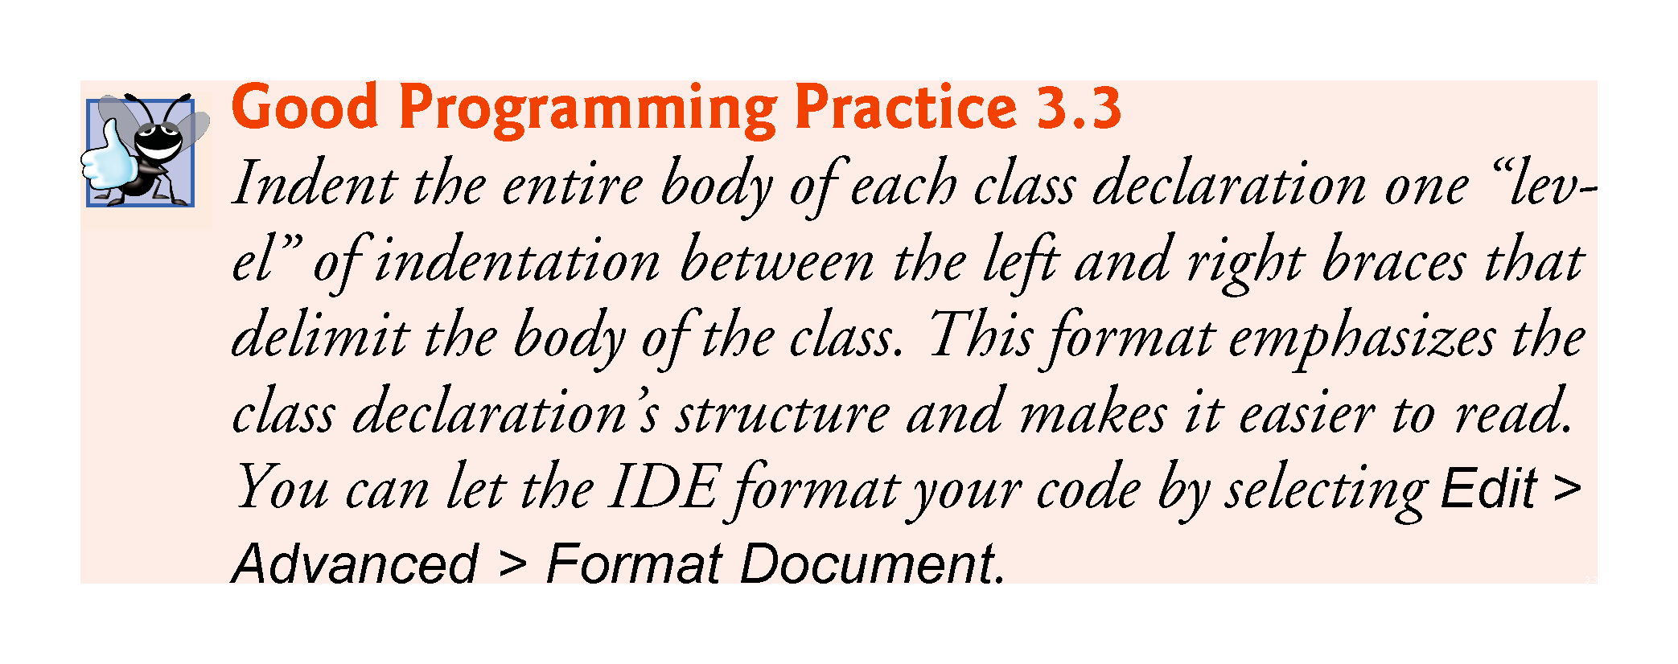

Slide 26
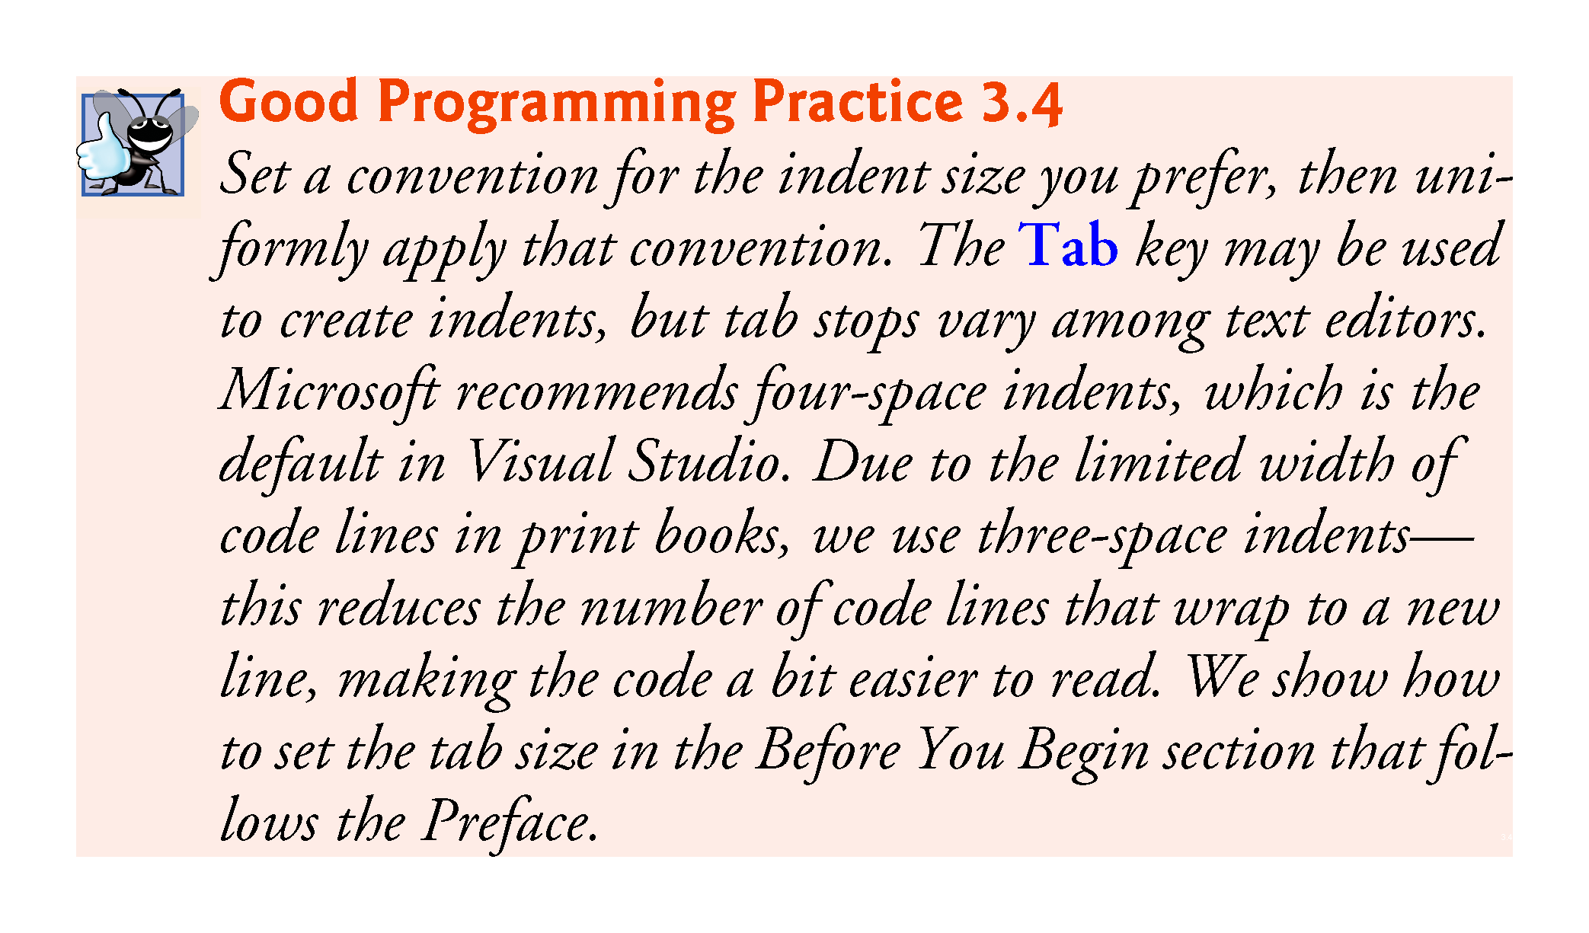

Slide 27
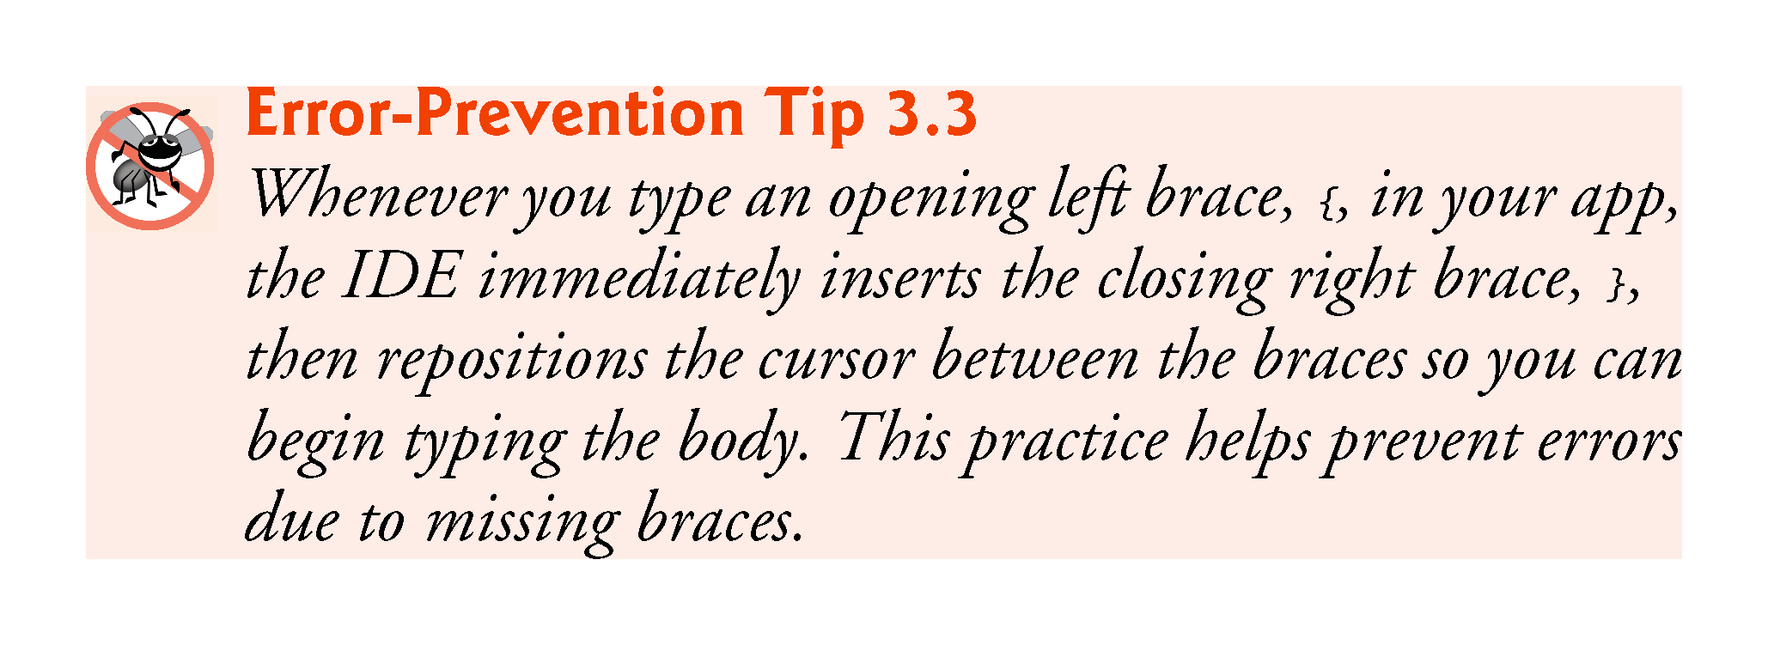

Slide 28
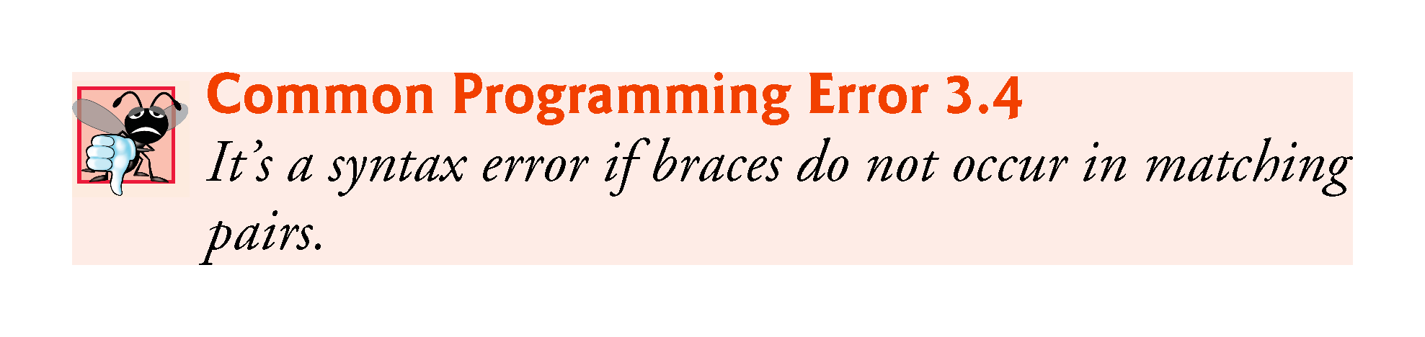

Slide 29
3.2.5 Main Method
Parentheses after an identifier indicate that it is an app building block called a method. Class declarations normally contain one or more methods.
Method names usually follow the same casing capitalization conventions used for class names.
For each app, one of the methods in a class must be called Main; otherwise, the app will not execute.
A method performs a task and returns information it completes its task.
Keyword void indicates that Main will not return any information.
The body of a method declaration begins with a left brace and ends with a corresponding right brace.

Slide 30
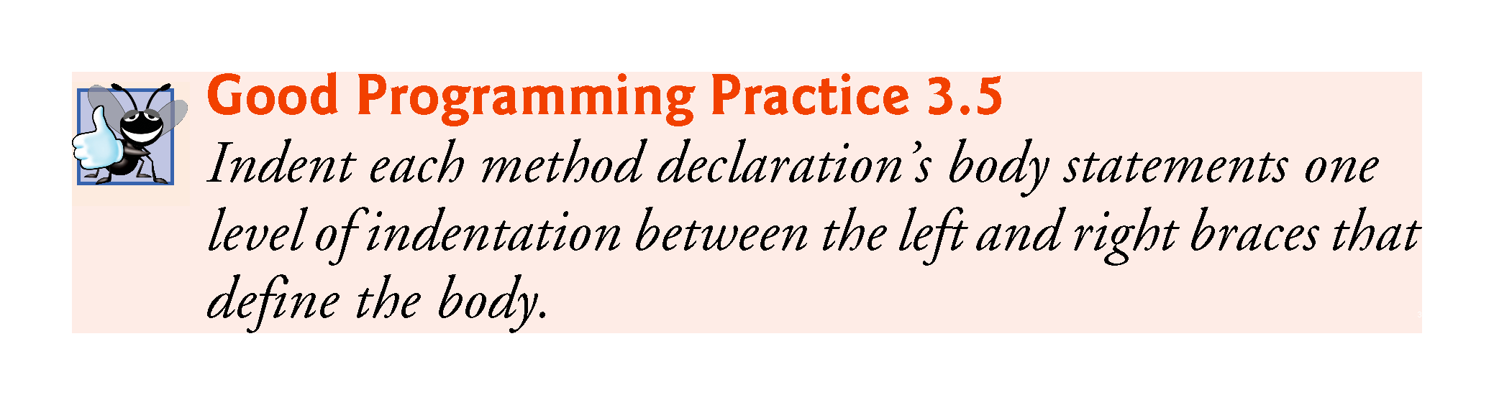

Slide 31
3.2.6 Displaying a Line of Text
Characters between double quotation marks are strings.
Whitespace characters in strings are not ignored by the compiler.
The Console.WriteLine method displays a line of text in the console window.
The string in parentheses is the argument to the Console.WriteLine method.
Method Console.WriteLine performs its task by displaying (also called outputting) its argument in the console window.

Slide 32
3.2.6 Displaying a Line of Text
A method is typically composed of one or more statements that perform the method’s task.
Most statements end with a semicolon.

Slide 33
3.3.1 Creating the Console App
Select File > New > Project… to display the New Project dialog (Fig. 3.3).
At the left side of the dialog, under Installed > Templates > Visual C# select the Windows category, then in the middle of the dialog select the Console Application template.
In the dialog’s Name field, type Welcome1, then click OK to create the project.

Slide 34
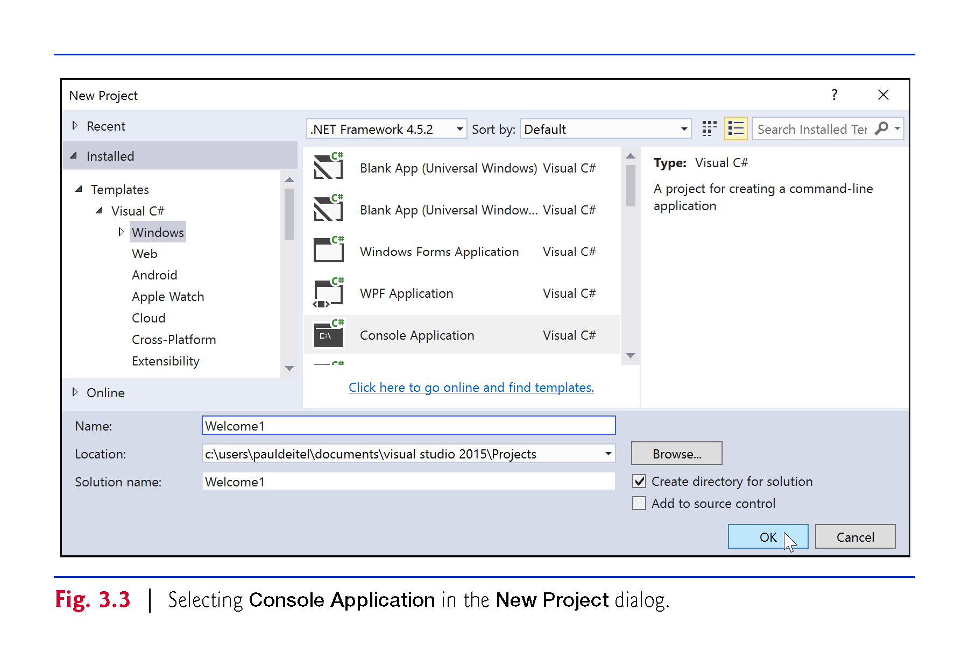

Slide 35
3.3 Creating a Simple App in Visual Studio (Cont.)
The IDE now contains the open console app.
The code coloring scheme used by the IDE is called syntax-color highlighting and helps you visually differentiate code elements.

Slide 36
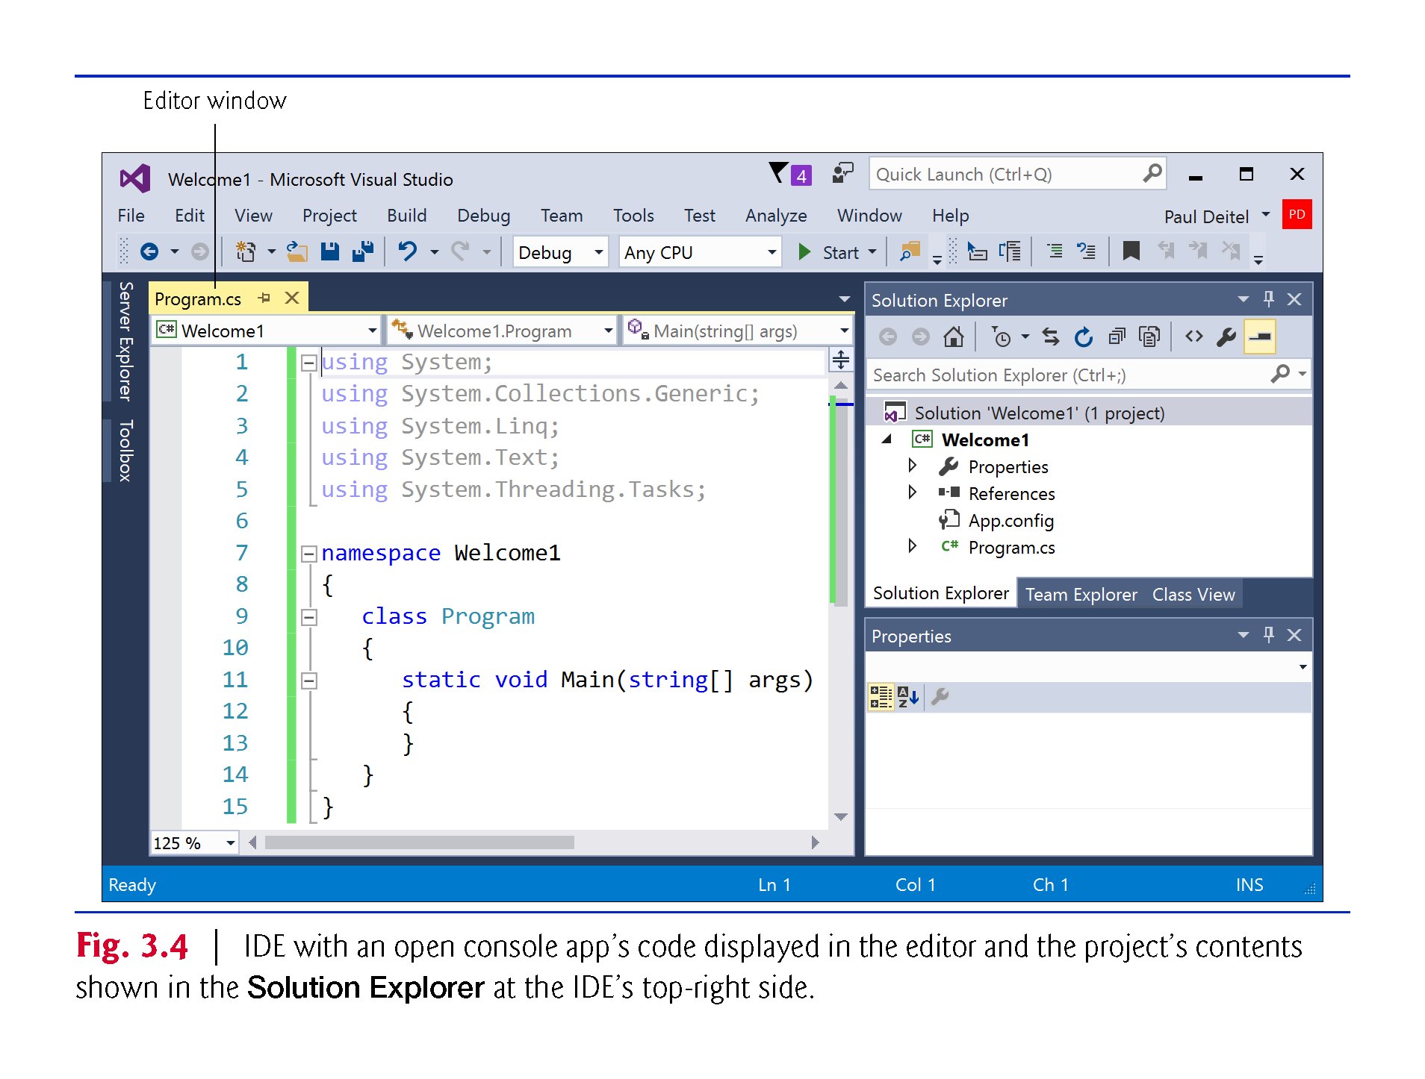

Slide 37
3.3.2 Changing the Name of the App File
To rename the app file, right click Program.cs in the Solution Explorer window and select Rename window
Type Welcome1 then press Enter.

Slide 38
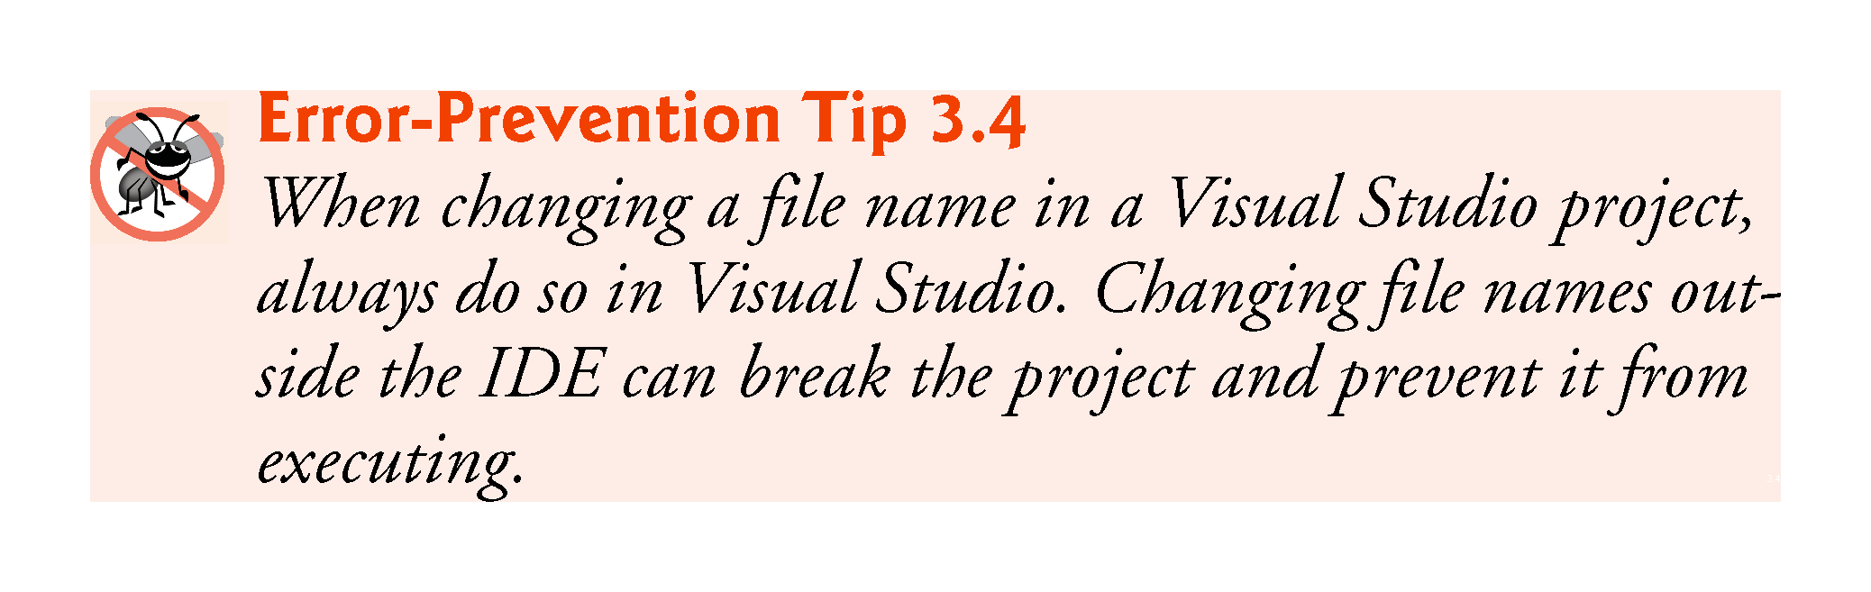

Slide 39
3.3.3 Writing Code and Using IntelliSense
IntelliSense lists a class’s members, which include method names.
As you type, IntelliSense lists various items that start with or contain the letters you’ve typed so far.
IntelliSense also displays a tool tip containing a description of the first matching item.

Slide 40
3.3.3 Writing Code and Using IntelliSense
You can either type the complete member name, double click the member name in the member list or press the Tab key to complete the name.
While the IntelliSense window is displayed pressing the Ctrl key makes the window transparent so you can see the code behind the window.

Slide 41
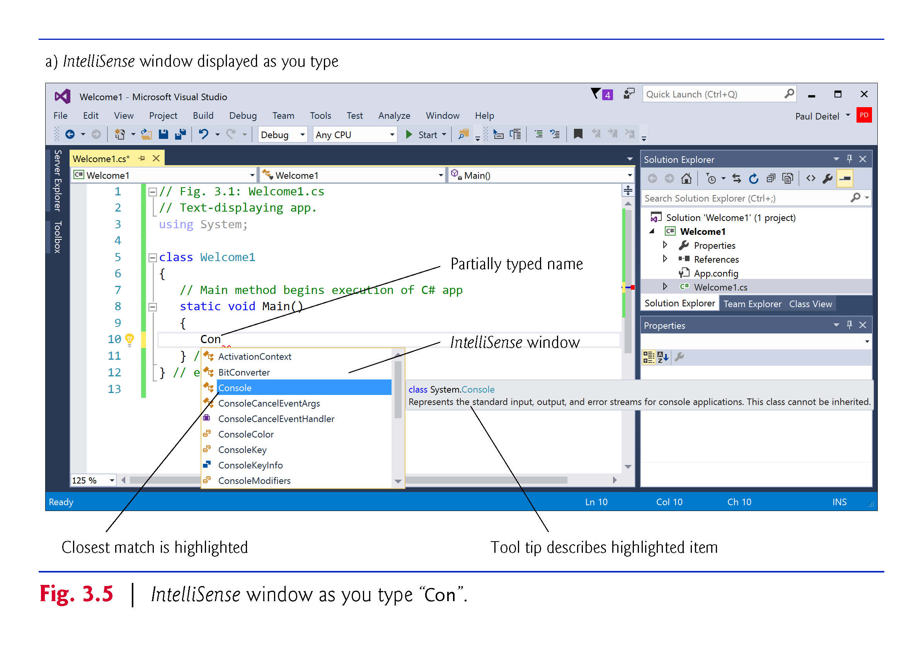

Slide 42
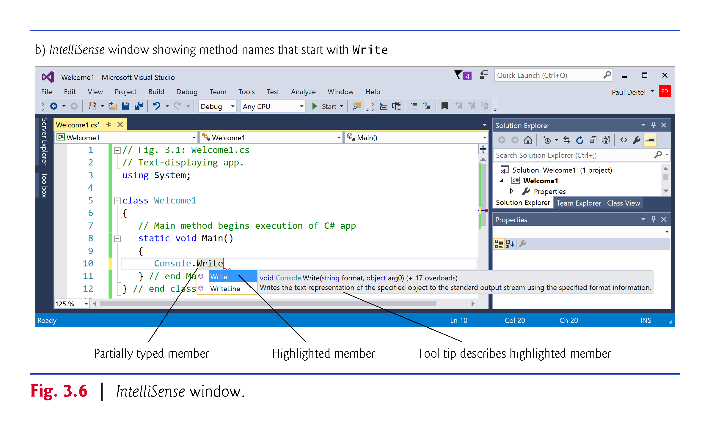

Slide 43
3.3.3 Writing Code and Using IntelliSense
When you type the open parenthesis character, (, after a method name, the Parameter Info window is displayed (Fig. 3.7).
This window contains information about the method’s parameters.
Up and down arrows allow you to scroll through overloaded versions of the method.

Slide 44
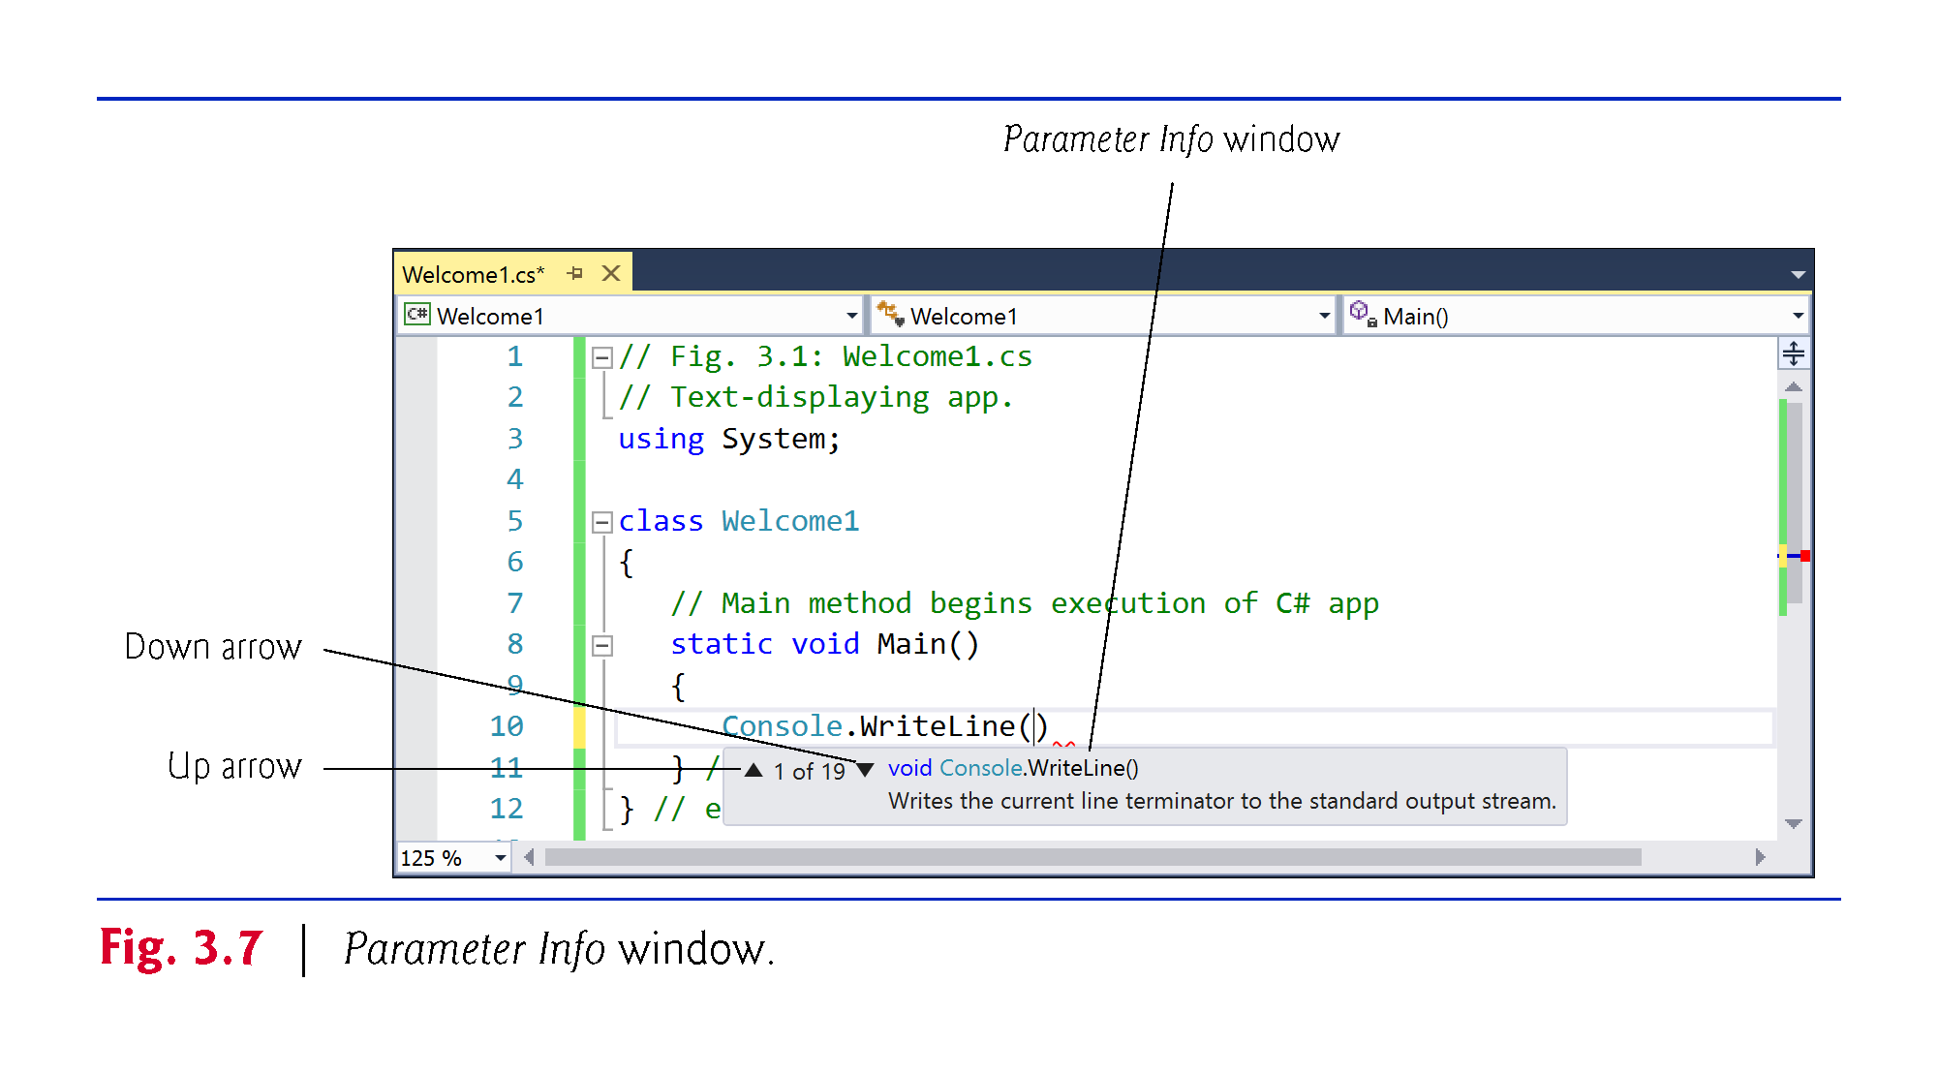

Slide 45
3.3.4 Compiling and Running the App
To compile the app, select Build > Build Solution.
This invokes the Main method.
Figure 3.8 shows the results of executing this app, displayed in a console (Command Prompt) window.

Slide 46
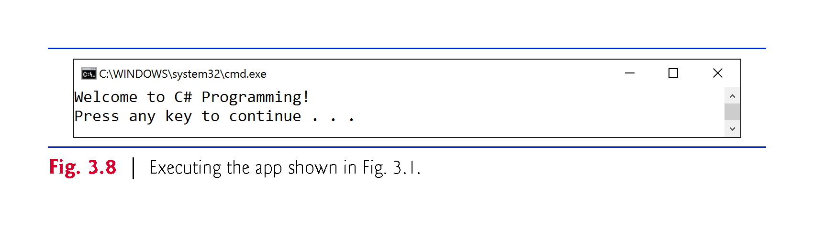

Slide 47
3.3.5 Errors, Error Messages and the Error List Window
As you type code, the IDE responds either by applying syntax-color highlighting or by generating a syntax error.
A syntax error indicates a violation of Visual C#’s rules for creating correct apps.
When a syntax error occurs, the IDE underlines the location of the error with a red squiggly line and provides a description of it in the Error List window (Fig. 3.9).

Slide 48
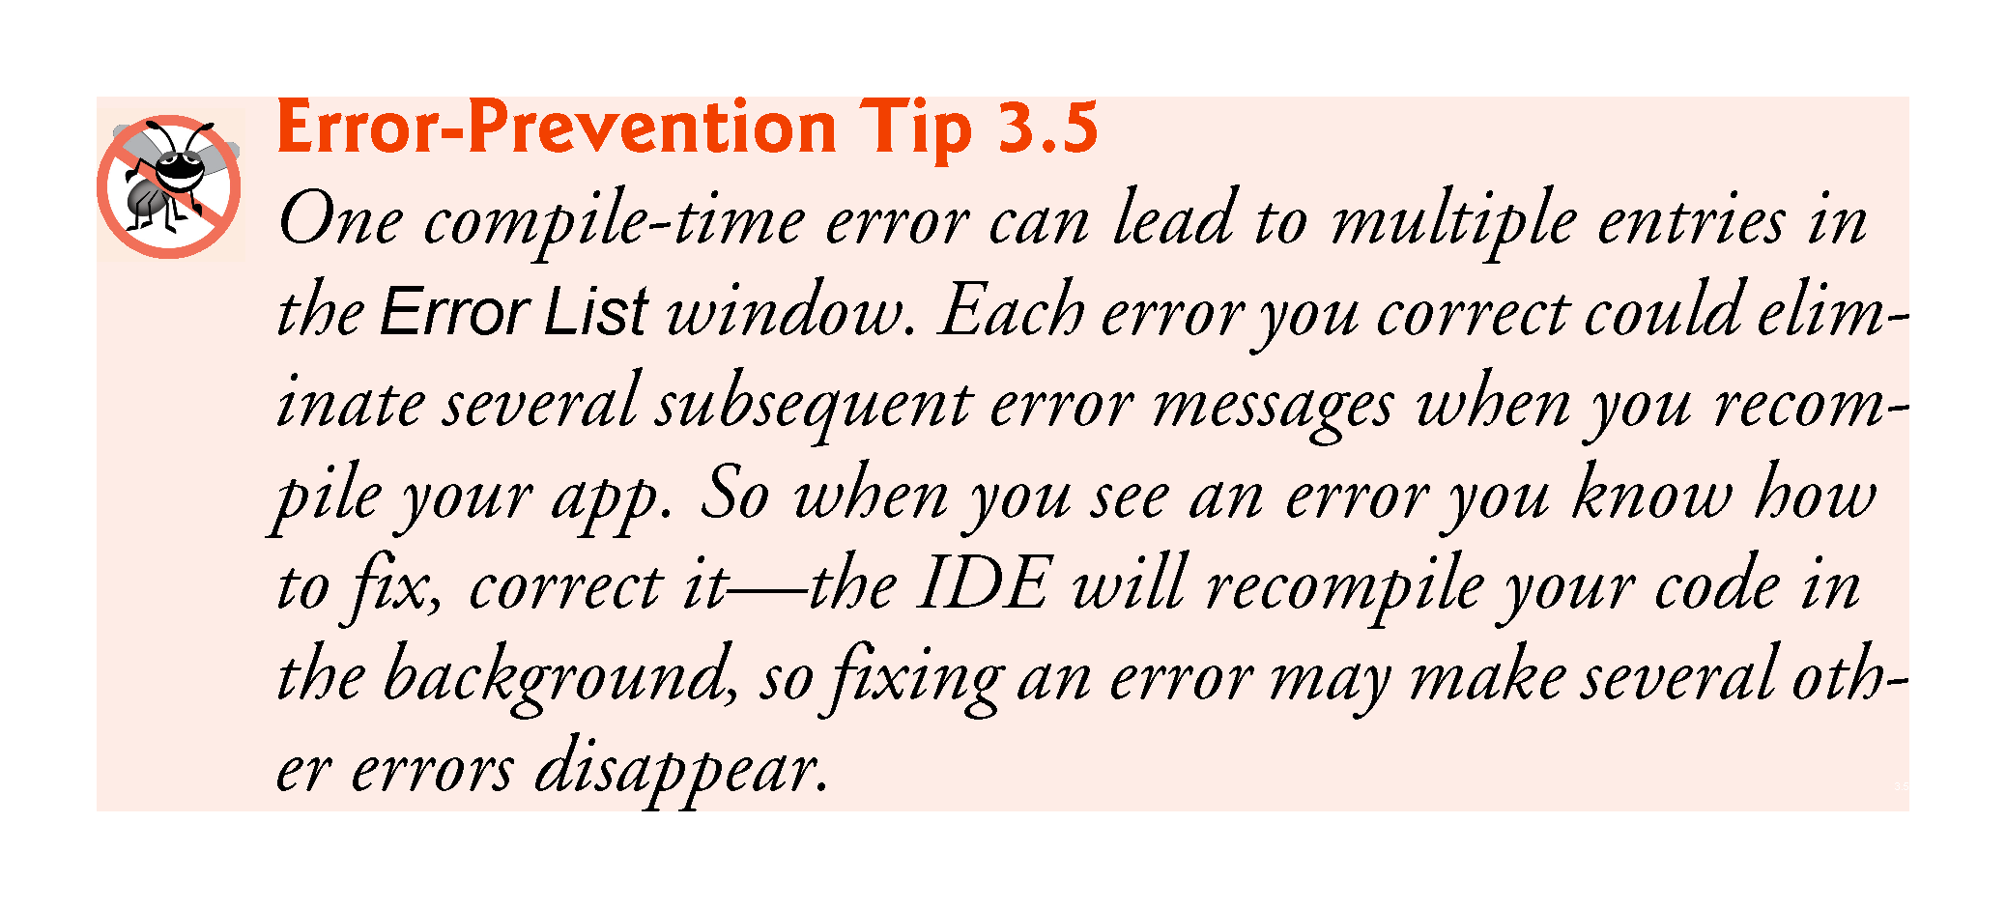

Slide 49
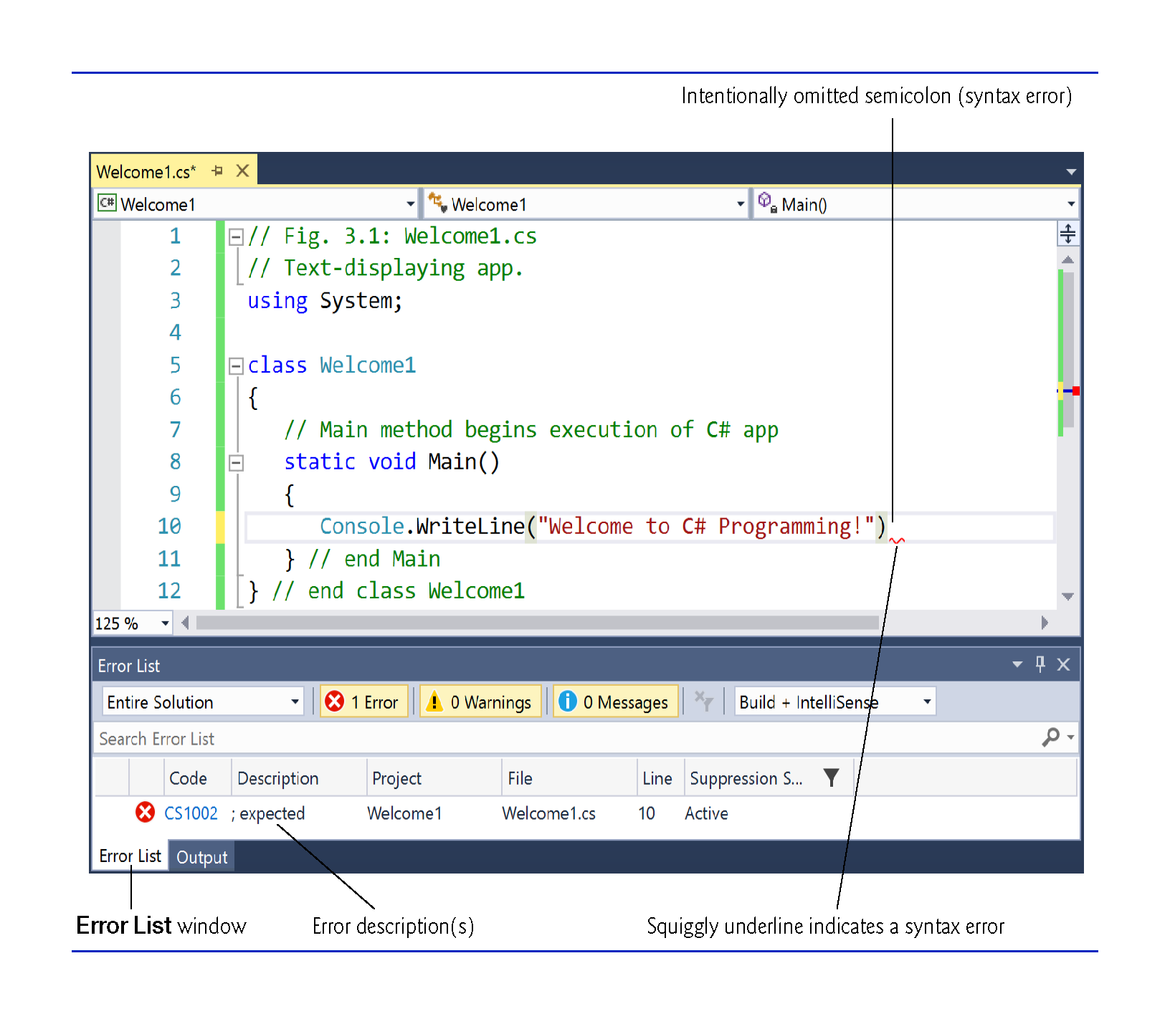

Slide 50
3.4.1 Displaying a Single Line of Text with Multiple Statements
Class Welcome2, shown in Fig. 3.10, uses two statements to produce the same output as that shown in the previous example.
Unlike WriteLine, the Console class’s Write method does not position the screen cursor at the beginning of the next line in the console window.

Slide 51
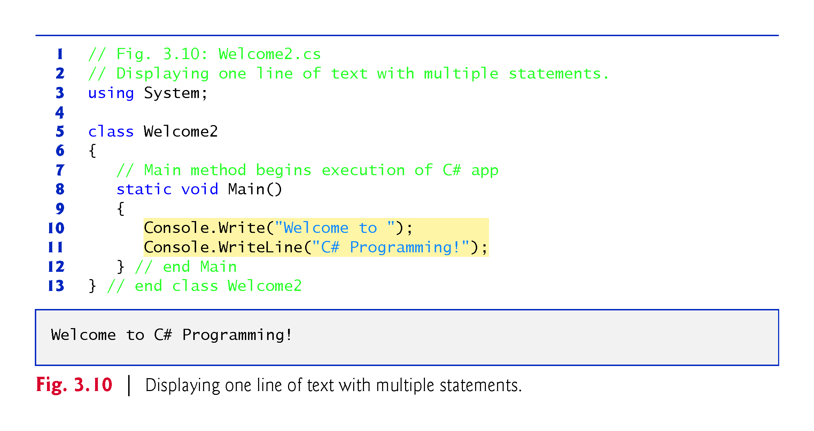

Slide 52
3.4.2 Displaying Multiple Lines of Text with a Single Statement
A single statement can display multiple lines by using newline characters.
Like space characters and tab characters, newline characters are whitespace characters.
The app of Fig. 3.11 outputs four lines of text, using newline characters to indicate when to begin each new line.

Slide 53
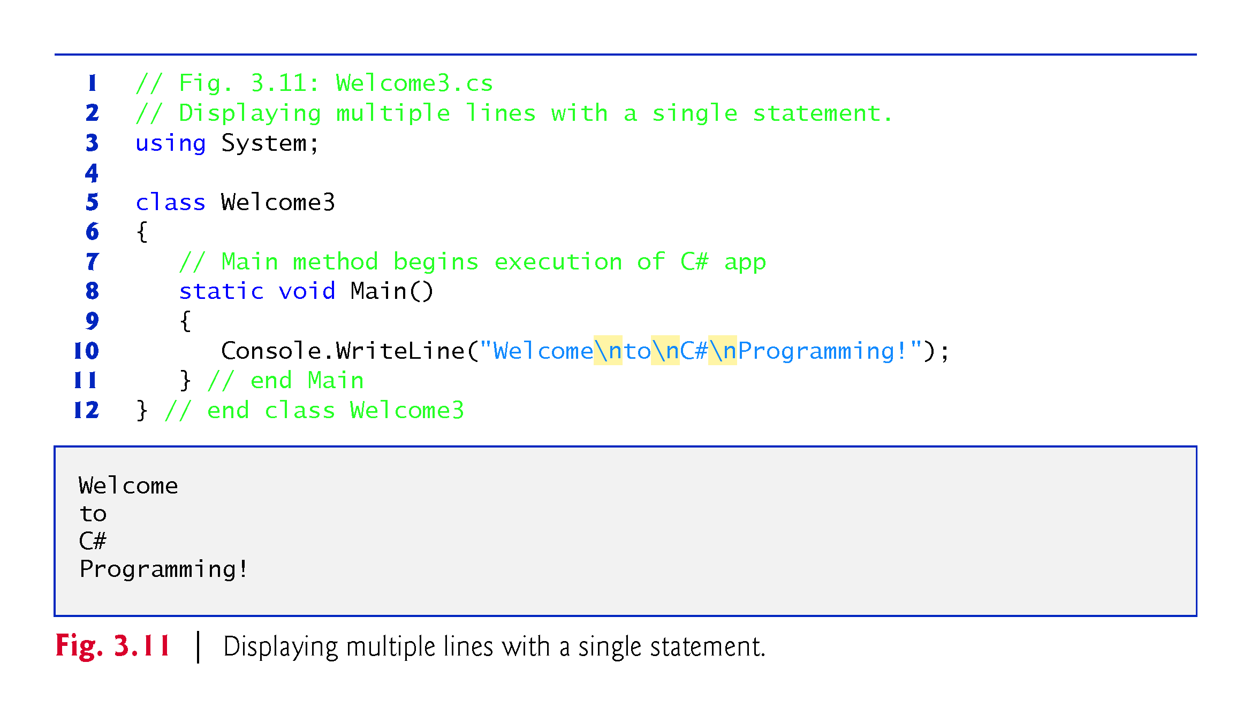

Slide 54
3.4.2 Displaying Multiple Lines of Text with a Single Statement
The backslash (\) is called an escape character, and is used as the first character in an escape­ sequence.
The escape sequence \n represents the newline character.
Figure 3.12 lists several common escape sequences and describes how they affect the display of characters in the console window.

Slide 55
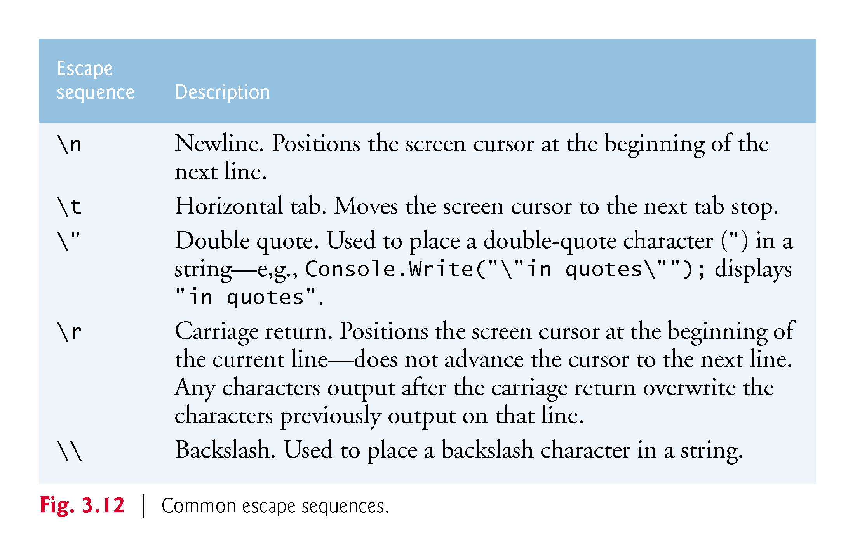

Slide 56
3.5 String Interpolation
Many programs format data into strings.
C# 6 introduces a mechanism called string interpolation that enables you to insert values in string literals to create formatted strings.
Figure 3.13 demonstrates this capability.

Slide 57
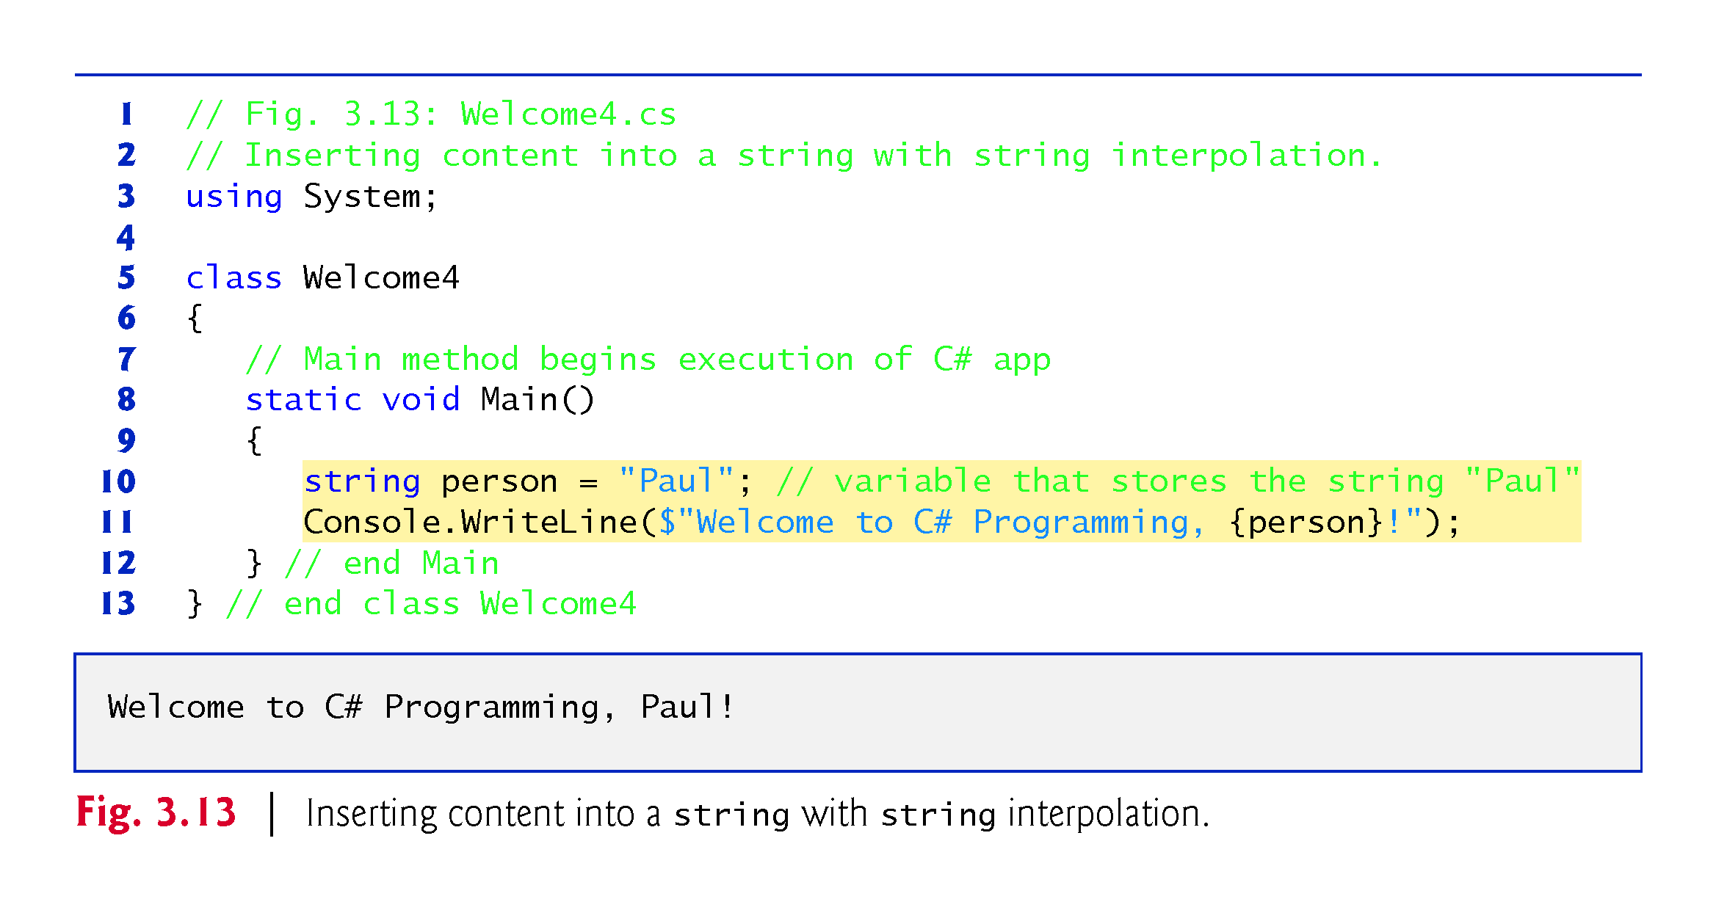

Slide 58
3.5 String Interpolation
A variable declaration statement (also called a declaration) specifies the name and type of a variable.
A variable is a location in the computer’s memory where a value can be stored for later use.
Variables are declared with a name and a type before they’re used:
A variable’s name enables the app to access the corresponding value in
A variable’s type specifies what kind of information is stored at that location in memory.
Variables of type string store character-based information.
Like other statements, declaration statements end with a semicolon (;).

Slide 59
3.5 String Interpolation
string interpolation inserts values into a string.
An interpolated string must begin with a $ (dollar sign). Then, you can insert interpolation expressions enclosed in braces, {}, anywhere between the quotes ("").
When C# encounters an interpolated string, it replaces each braced interpolation expression with the corresponding value.

Slide 60
3.6 Another C# App: Adding Integers
Applications remember numbers and other data in the computer’s memory and access that data through app elements called variables.
A variable is a location in the computer’s memory where a value can be stored for use later in an app.
A variable declaration statement (also called a declaration) specifies the name and type of a variable.
A variable’s name enables the app to access the value of the variable in memory—the name can be any valid identifier.
A variable’s type specifies what kind of information is stored at that location in memory.

Slide 61
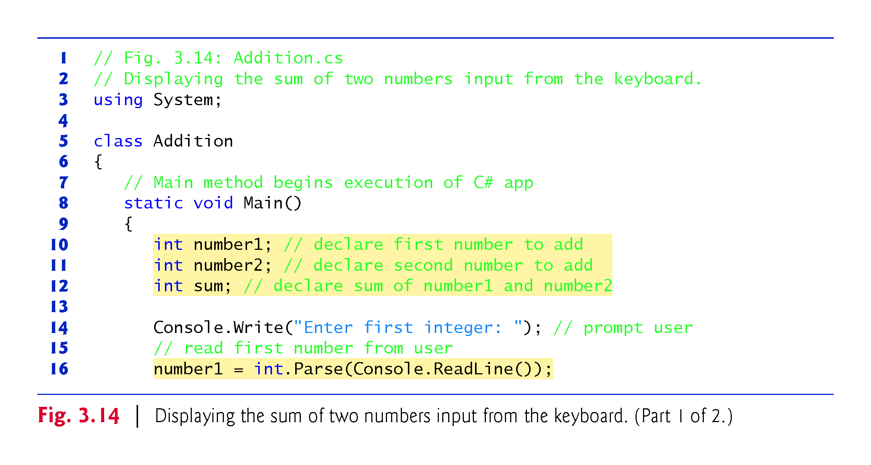

Slide 62
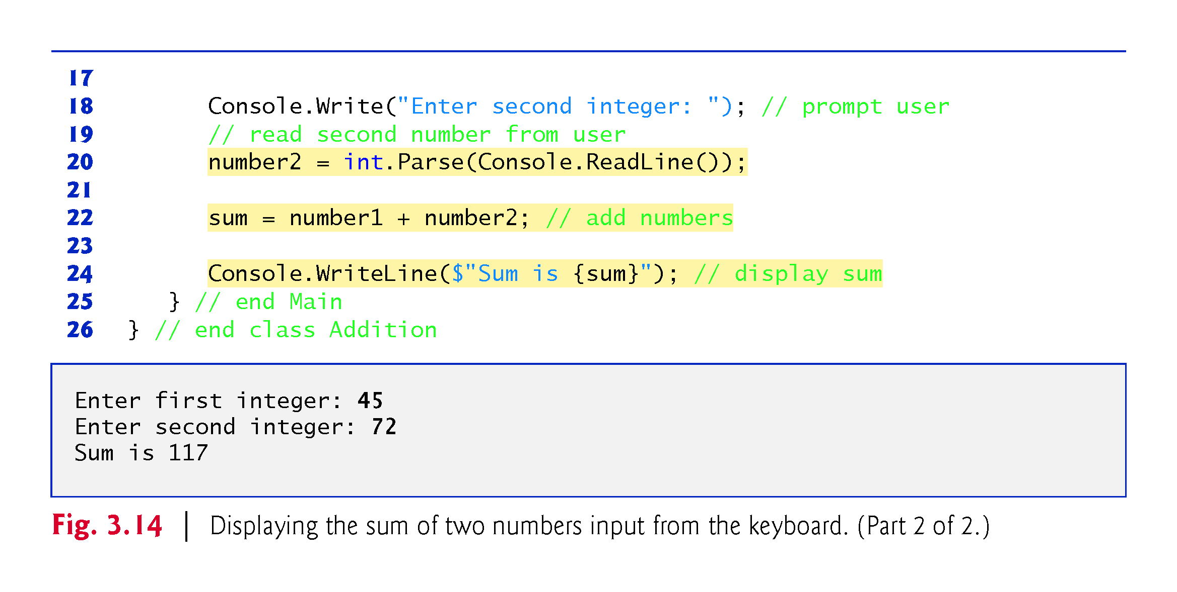

Slide 63
3.6.1 Declaring the int Variable number1
Variables of type int store integer values (whole numbers such as 7, –11, 0 and 31914).
Types float, double and decimal specify real numbers (numbers with decimal points).
Type char represents a single character.
These types are called simple types. Simple-type names are keywords and must appear in all lowercase letters.

Slide 64
3.6.2 Declaring Variables number2 and sum

Slide 65
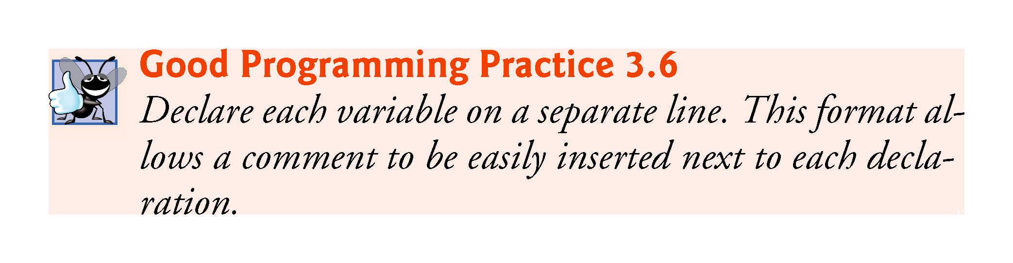

Slide 66
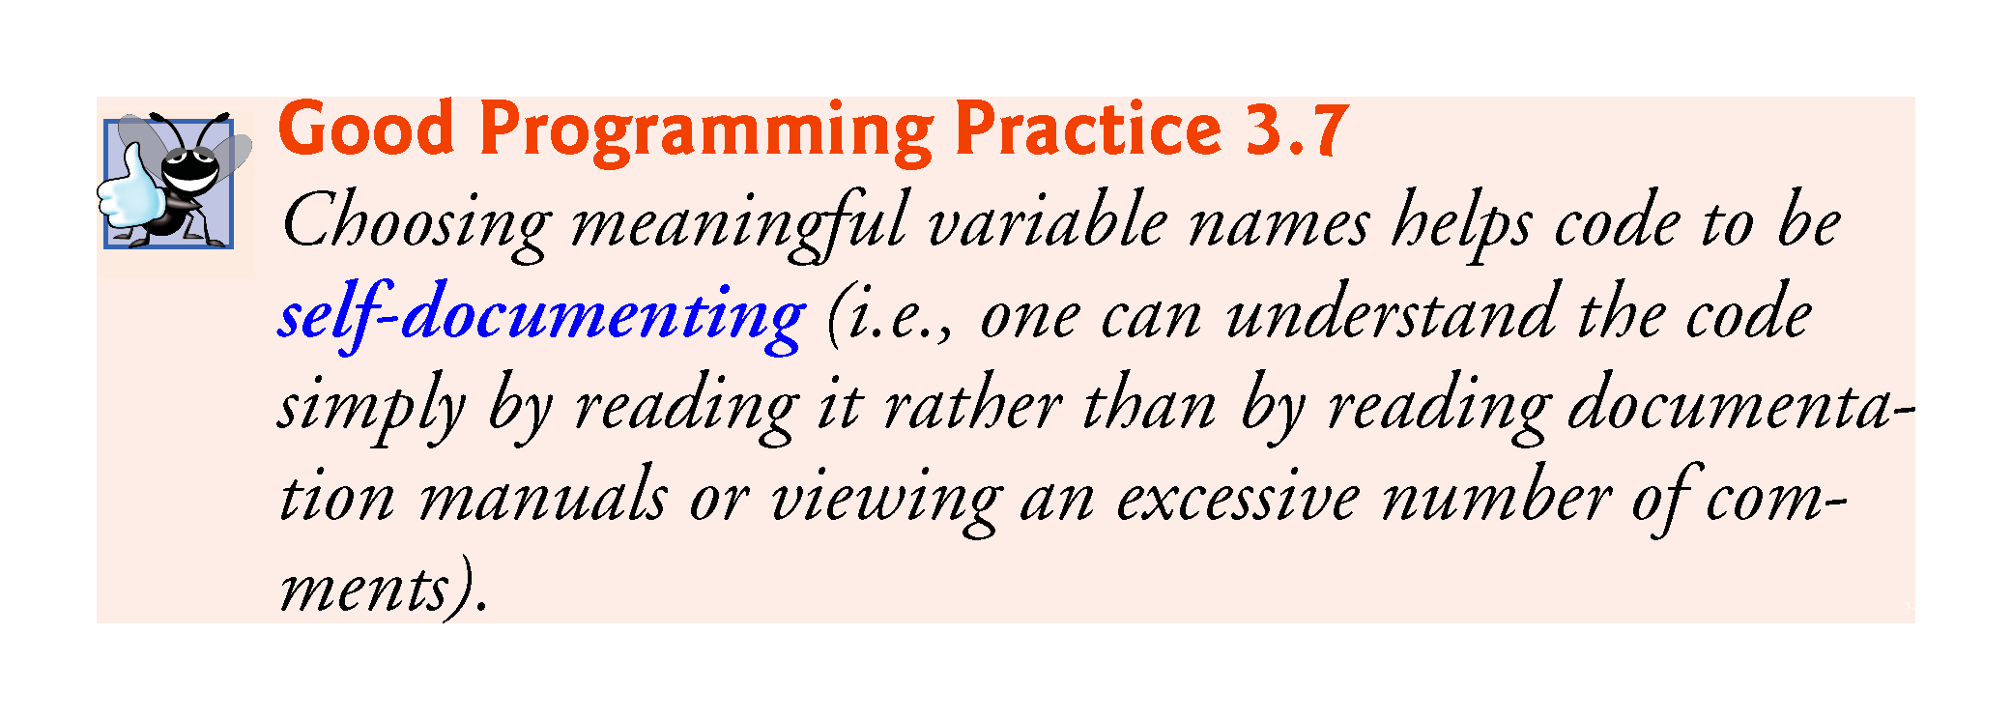

Slide 67
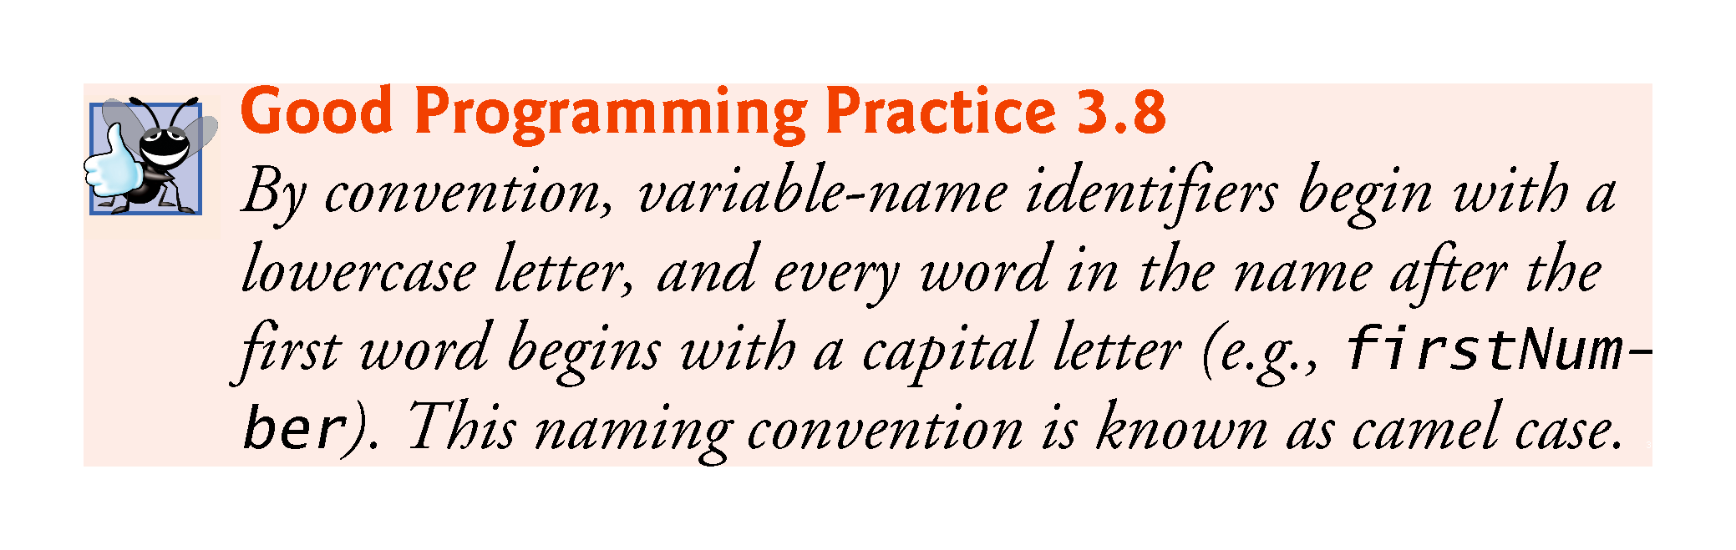

Slide 68
3.6.3 Prompting the User for Input
A prompt because it directs the user to take a specific action

Slide 69
3.6.4 Reading a Value into Variable number1
Console’s ReadLine method waits for the user to type a string of characters at the keyboardand press the Enter key.
ReadLine returns the text the user entered.
The int.Parse method converts this sequence of characters into data of type int.

Slide 70
3.6.4 Reading a Value into Variable number1
A value can be stored in a variable using the assignment operator, =.
Operator = is called a binary operator, because it works on two pieces of information, or operands.
An assignment statement assigns a value to a variable.
Everything to the right of the assignment operator, =, is always evaluated before the assignment is performed.

Slide 71


Slide 72
3.6.5 Summing number1 and number2
An expression is any portion of a statement that has a value associated with it.
The value of the expression number1 + number2 is the sum of the numbers.
The value of the expression Console.ReadLine() is the string of characters typed by the user.
Calculations can also be performed inside output statements.

Slide 73
3.7 Memory Concepts
Variable names actually correspond to locations in the computer’s memory.
Every variable has a name, a type, a size and a value.
In Fig. 3.15, the computer has placed the value 45 in the memory location corresponding to number1.

Slide 74
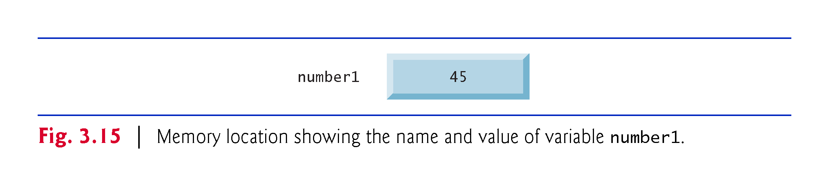

Slide 75
3.7 Memory Concepts (Cont.)
In Fig. 3.16, 72 has been placed in location number2.

Slide 76
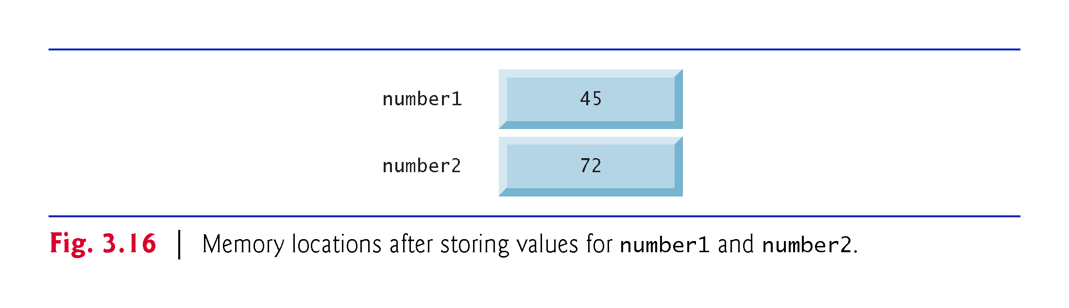

Slide 77
3.7 Memory Concepts (Cont.)
After sum has been calculated, memory appears as shown in Fig. 3.17.

Slide 78
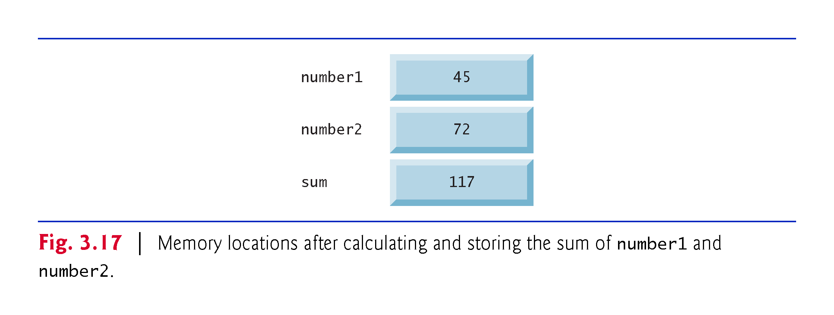

Slide 79
3.7 Memory Concepts (Cont.)
Whenever a value is placed in a memory location, the value replaces the previous value in that location, and the previous value is lost.
When a value is read from a memory location, the process is nondestructive.

Slide 80
3.8 Arithmetic
The arithmetic operators are summarized in Fig. 3.18.
The arithmetic operators in Fig. 3.18 are binary operators.

Slide 81
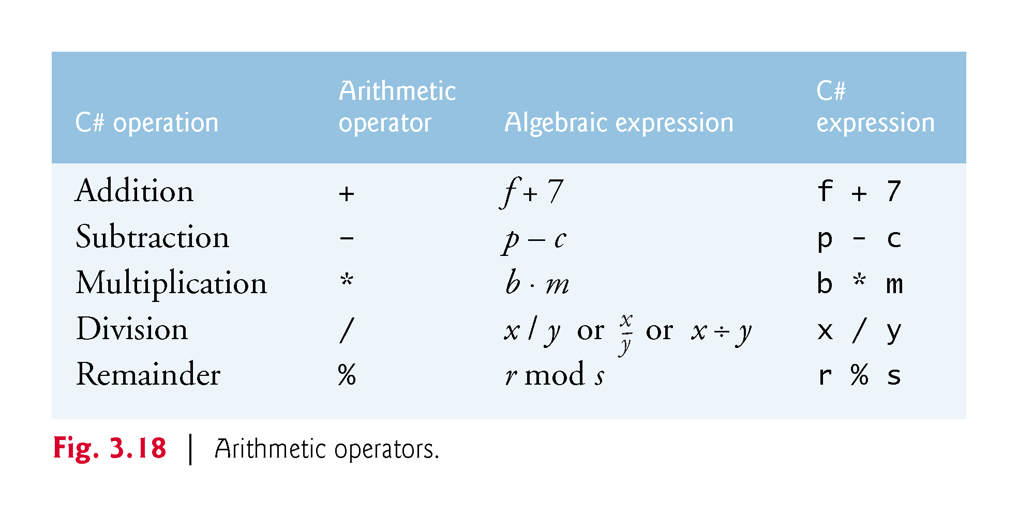

Slide 82
3.8 Arithmetic (Cont.)
Integer division yields an integer quotient—any fractional part in integer division is simply truncated (discarded)—no rounding occurs.
C# provides the remainder operator, %, which yields the remainder after division.
The remainder operator is most commonly used with integer operands but can also be used with floats, doubles, and decimals.

Slide 83
3.8 Arithmetic (Cont.)
Arithmetic expressions must be written in straight-line form to facilitate entering an app’s code into the computer.
Expressions such as “a divided by b” must be written as a / b in a straight line.
Parentheses are used to group terms in C# expressions in the same manner as in algebraic expressions.
If an expression contains nested parentheses, the expression in the innermost set of parentheses is evaluated first.

Slide 84
3.8 Arithmetic (Cont.)
Arithmetic operators are evaluated according to the rules of operator precedence, which are generally the same as those followed in algebra (Fig. 3.19).
As in algebra, it is acceptable to place unnecessary (redundant) parentheses in an ex­pression to make the expression clearer.

Slide 85
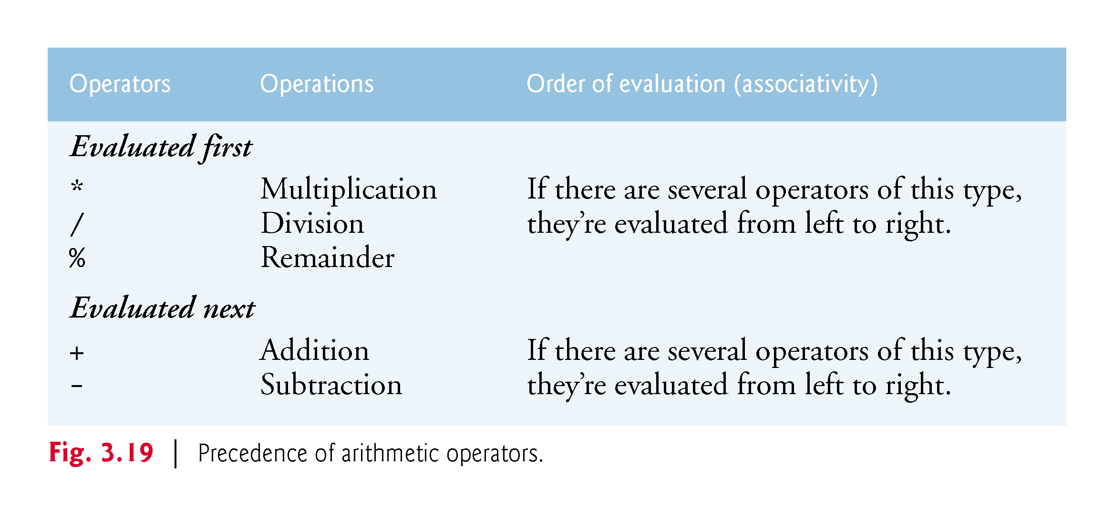

Slide 86
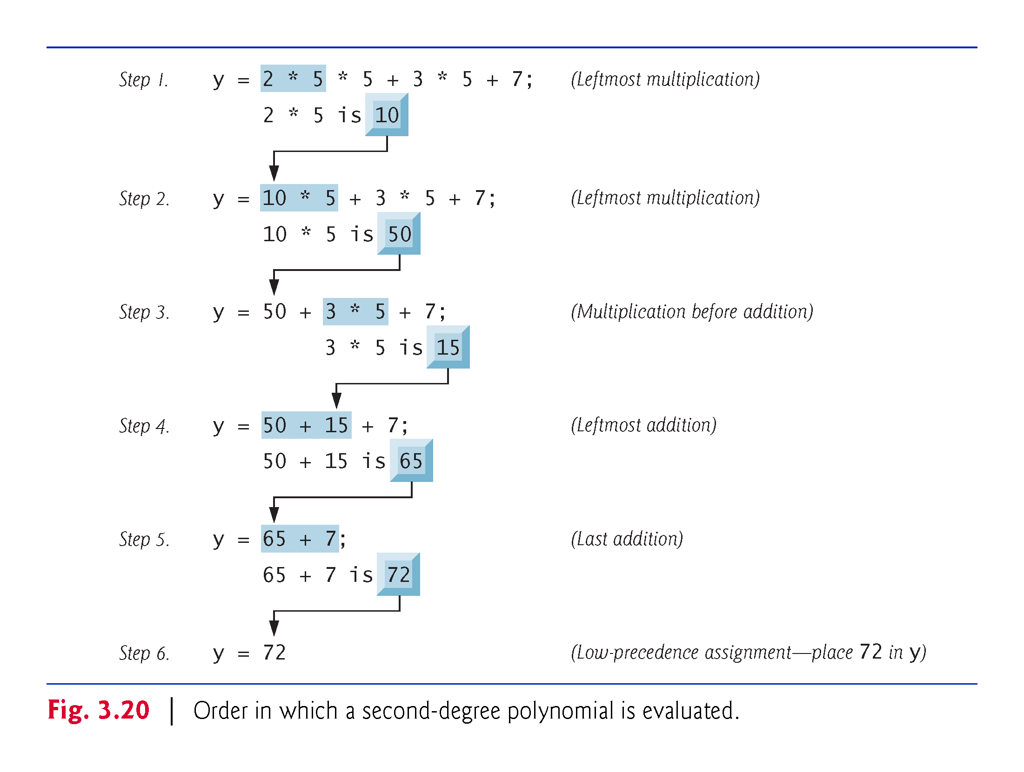

Slide 87
3.9 Decision Making: Equality and Relational Operators
A condition is an expression that can be either true or false.
Conditions can be formed using the equality operators (== and !=) and relational operators (>, <, >= and <=) summarized in Fig. 3.21.

Slide 88
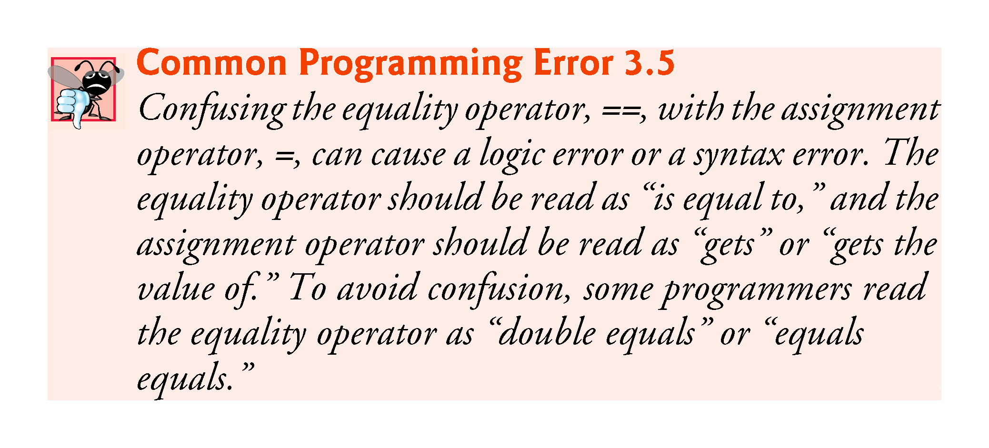

Slide 89
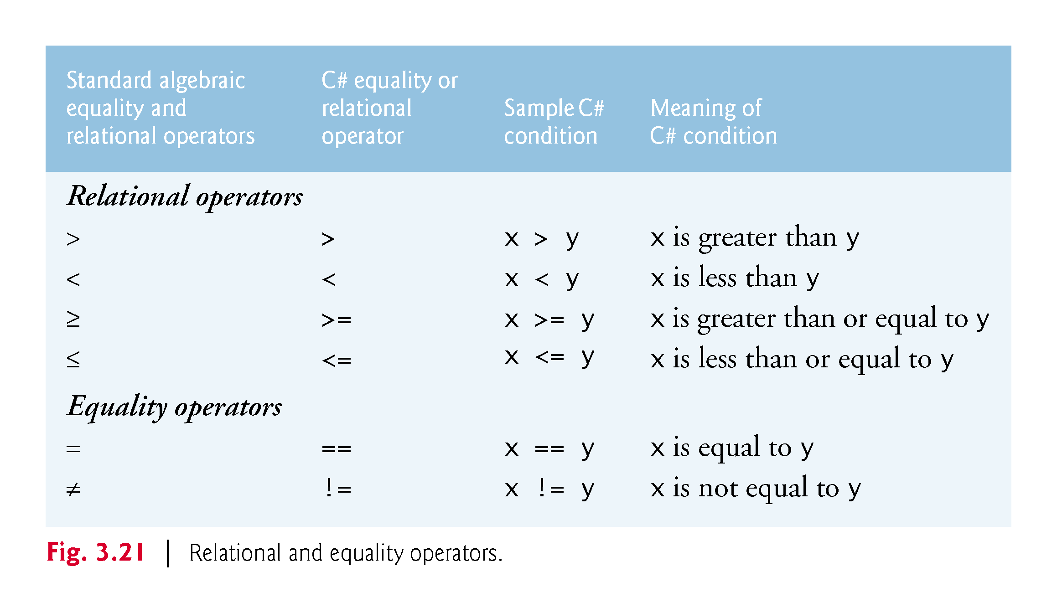

Slide 90
3.9 Decision Making: Equality and Relational Operators
Figure 3.22 uses six if statements to compare two integers entered by the user.

Slide 91
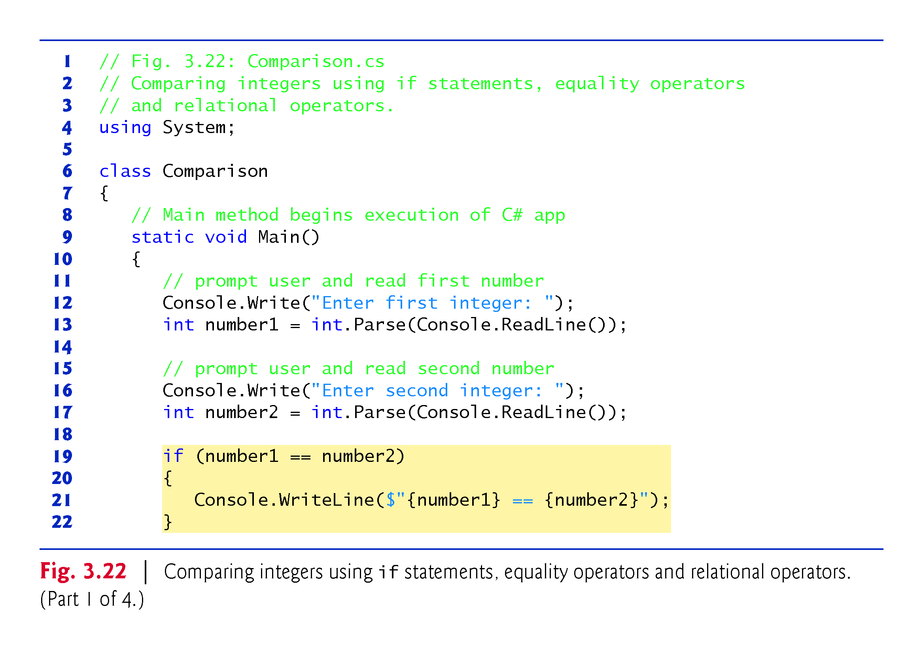

Slide 92
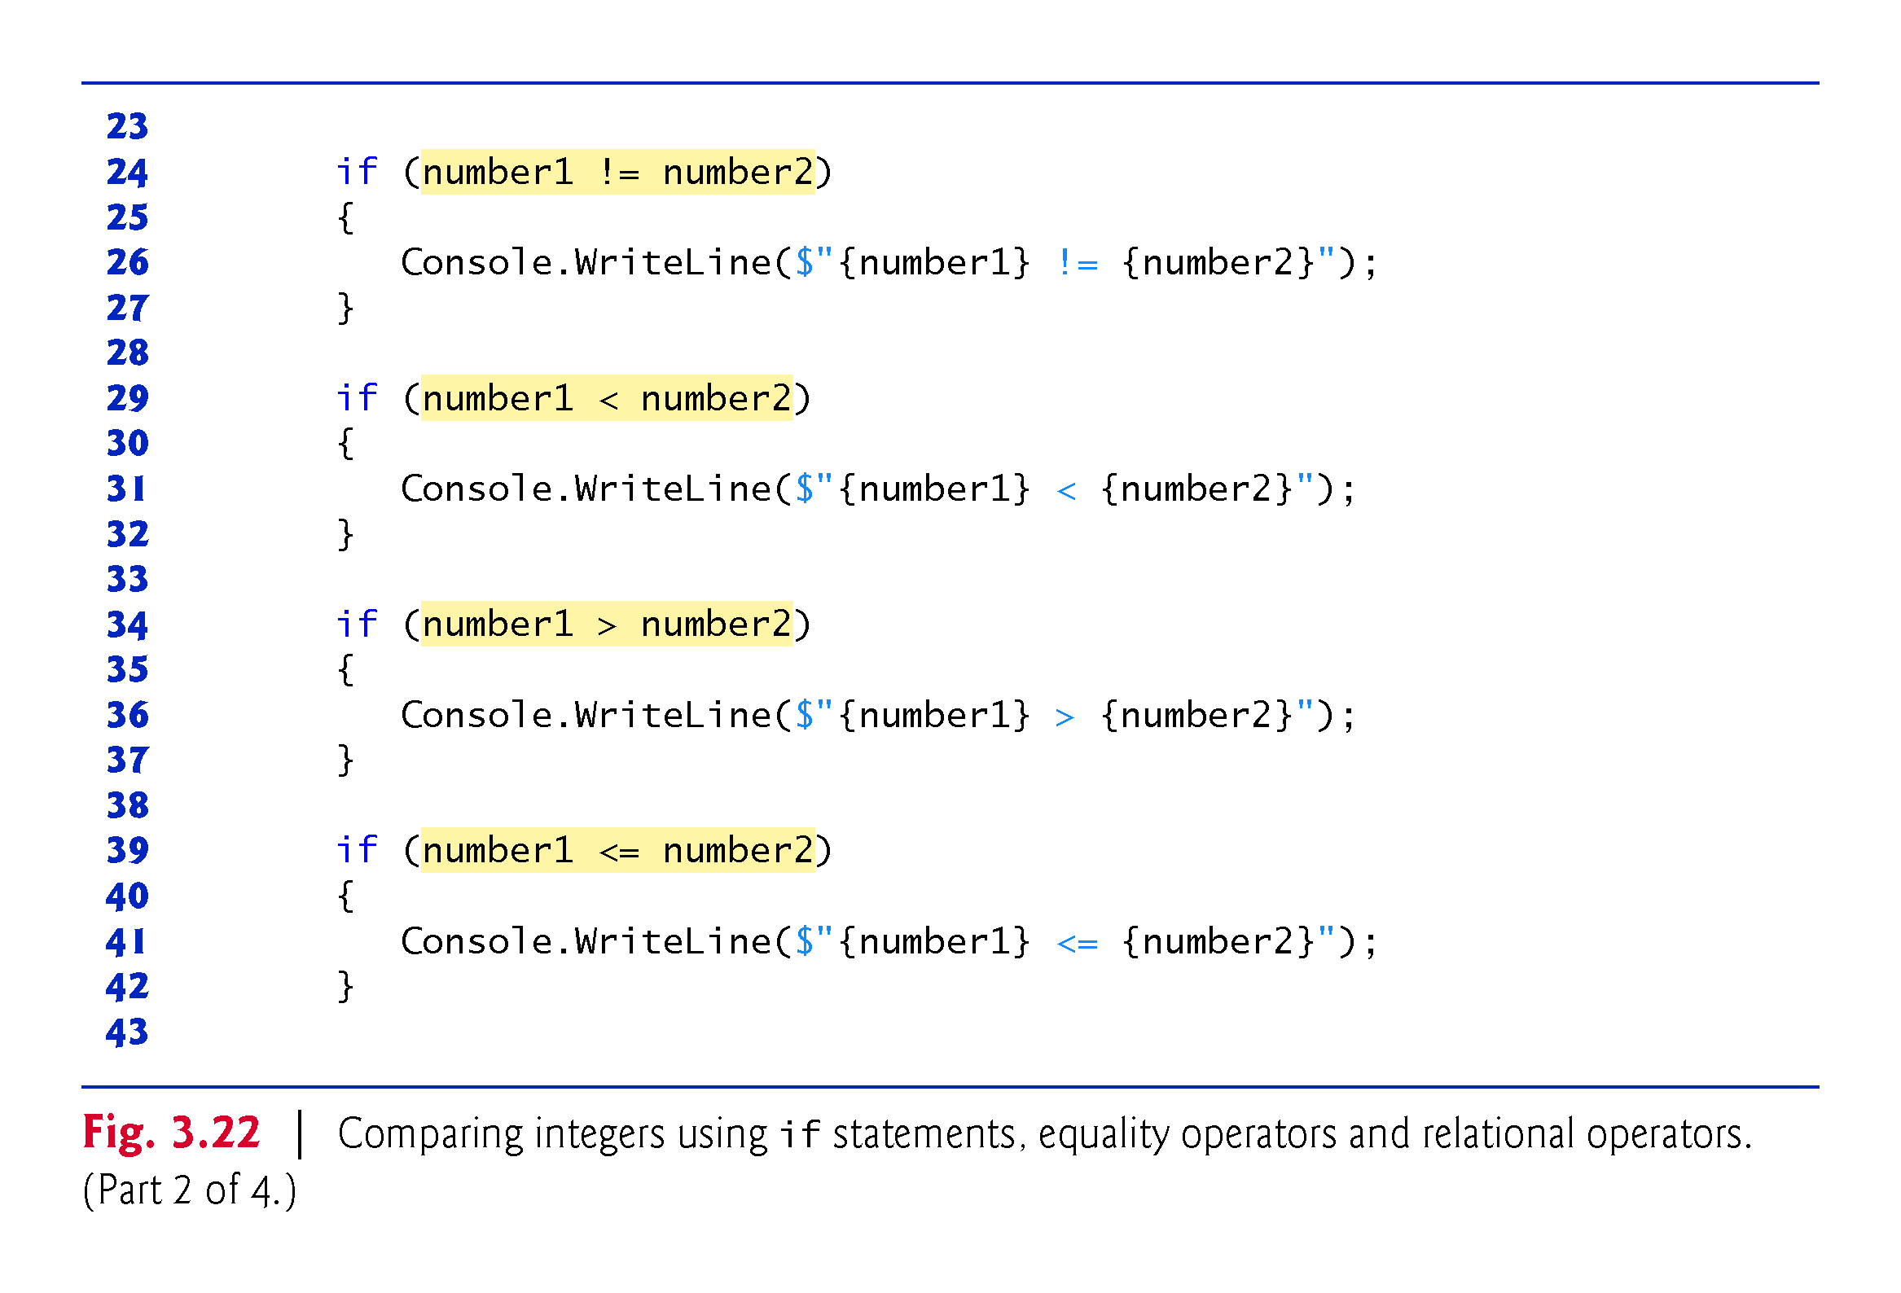

Slide 93
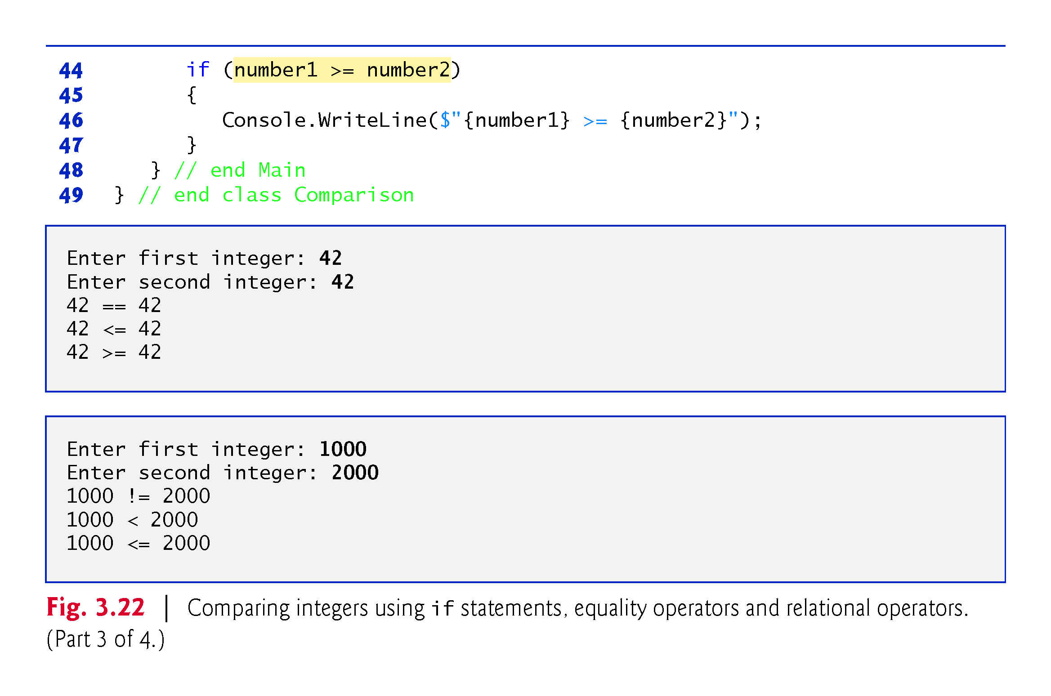

Slide 94
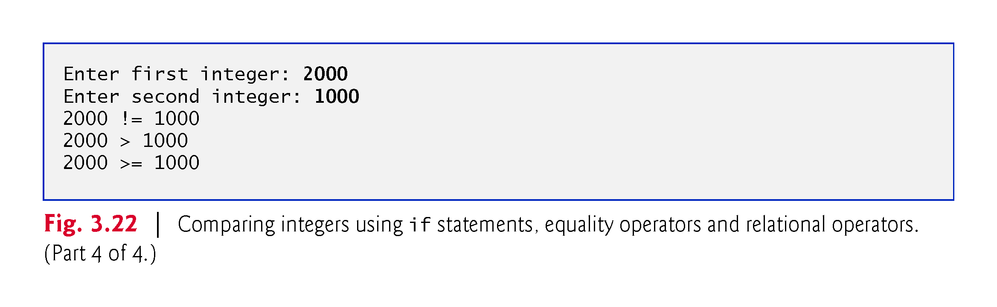

Slide 95
3.9 Decision Making: Equality and Relational Operators (Cont.)
If the condition in an if statement is true, the statement associated with that if statement executes.
An if statement always begins with keyword if, followed by a condition in parentheses.
An if statement expects one statement in its body.

Slide 96
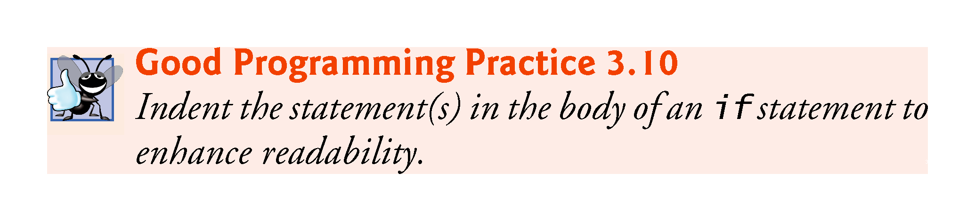

Slide 97
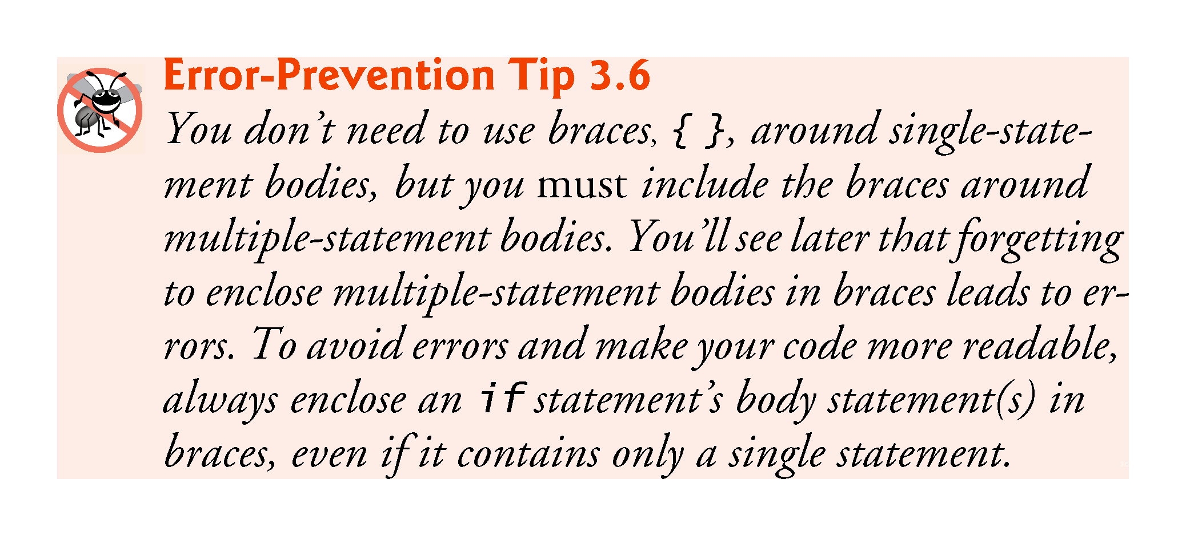

Slide 98
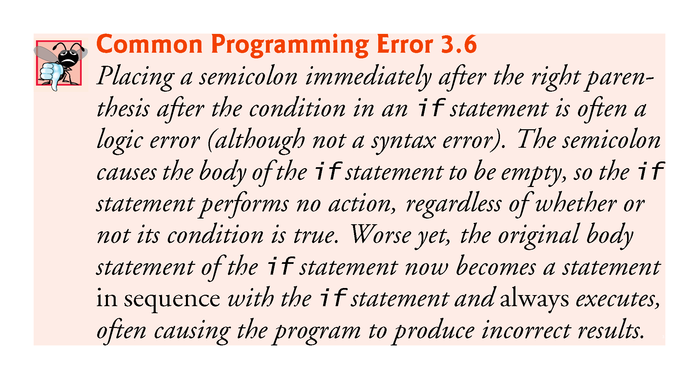

Slide 99


Slide 100
3.9 Decision Making: Equality and Relational Operators (Cont.)
Figure 3.23 shows the precedence of the operators introduced in this chapter from top to bottom in decreasing order of precedence.

Slide 101


Slide 102


